Slide 1
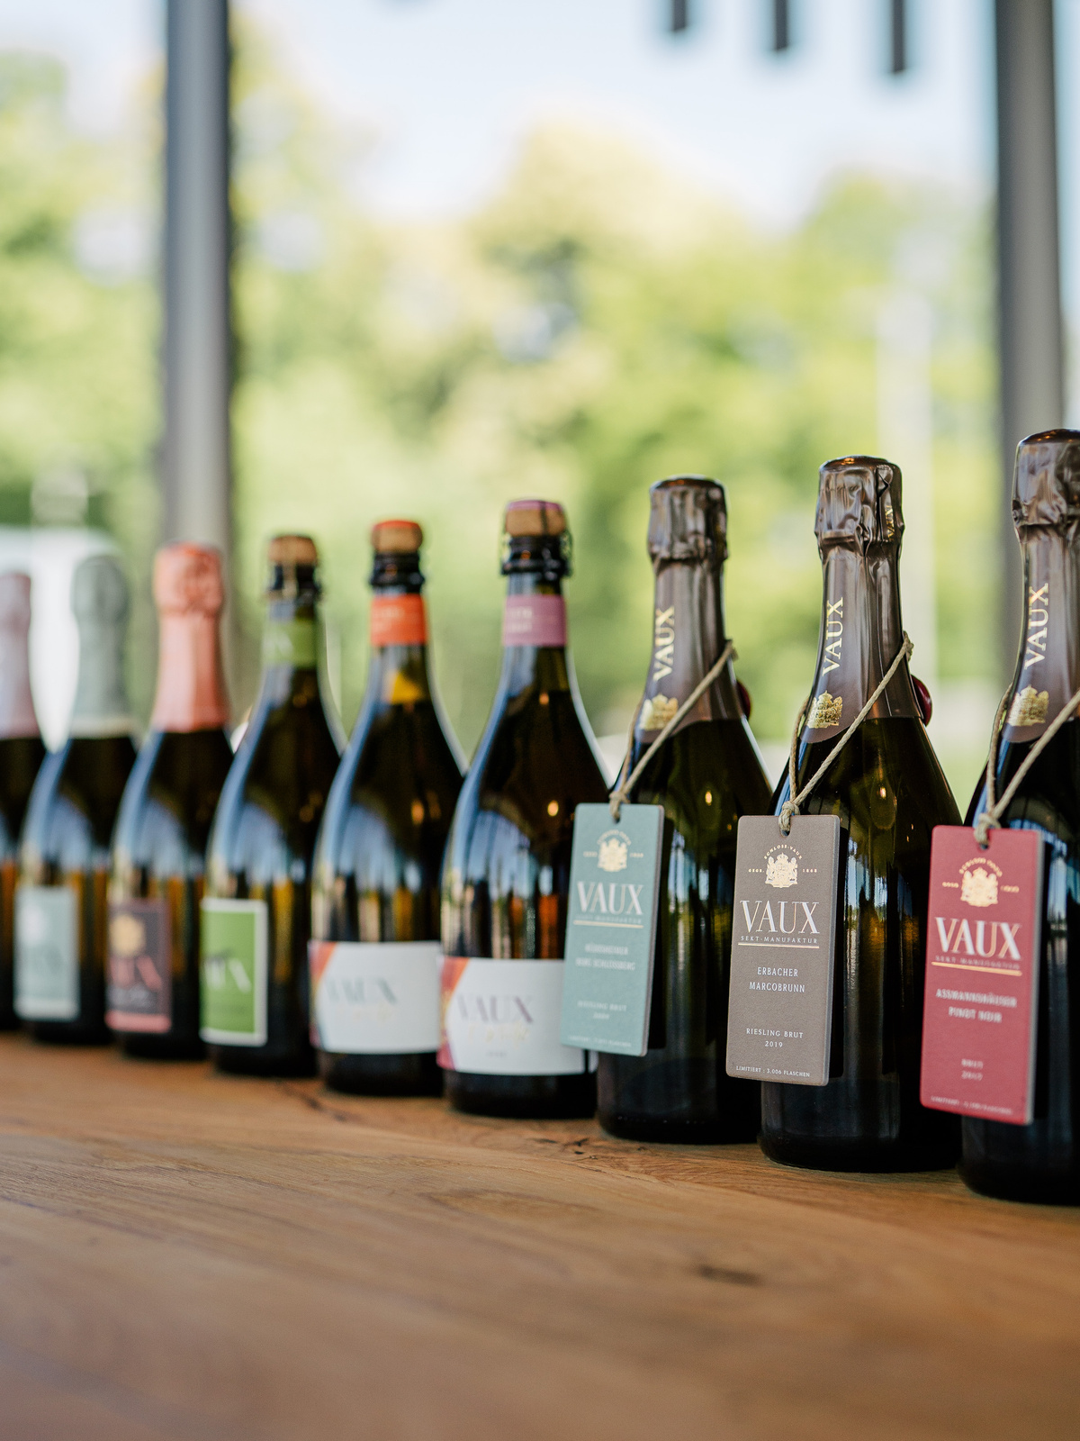
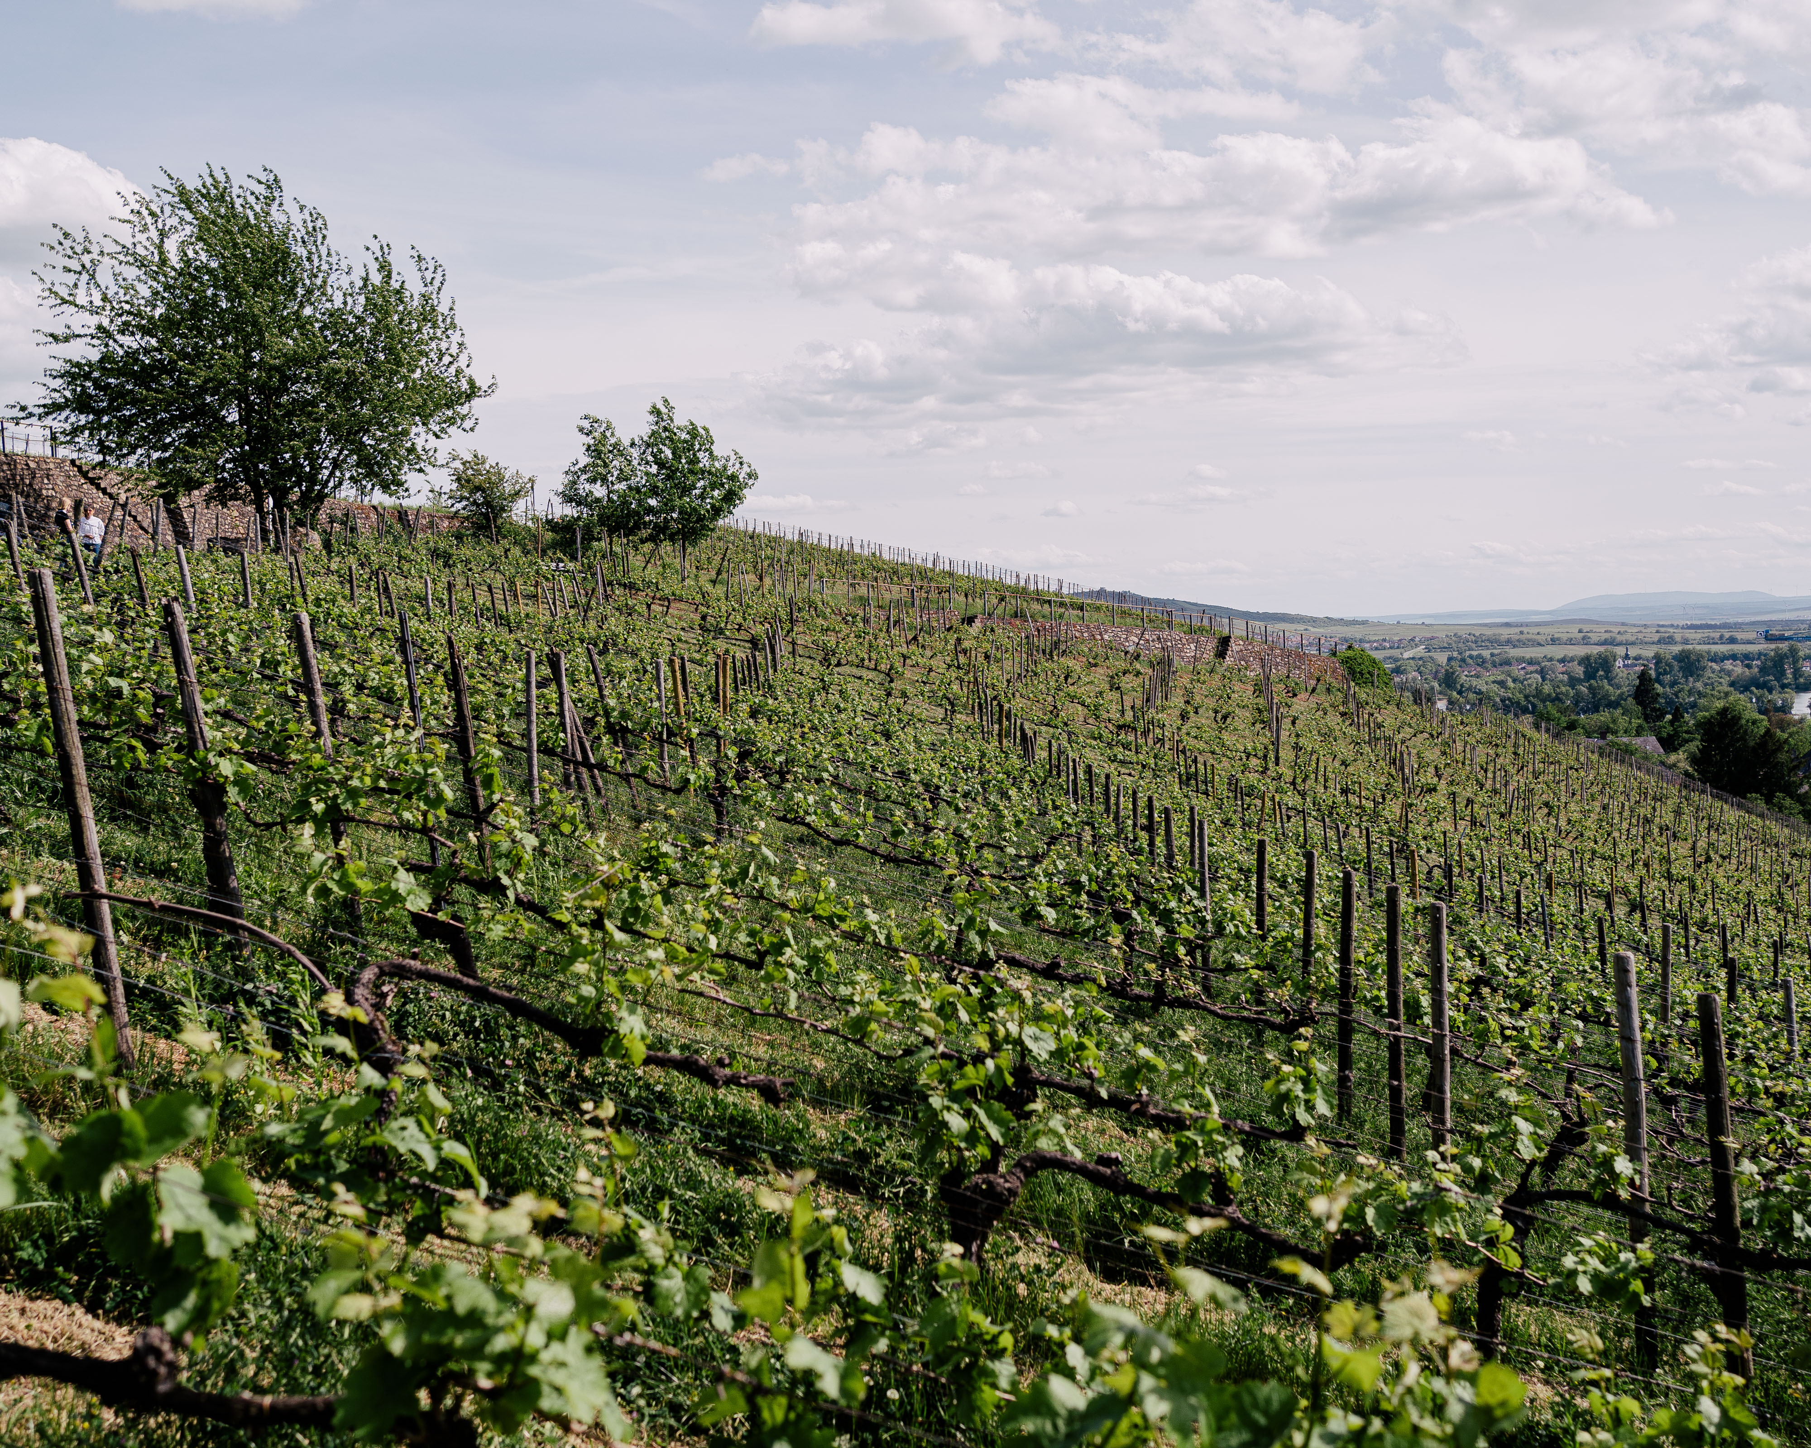
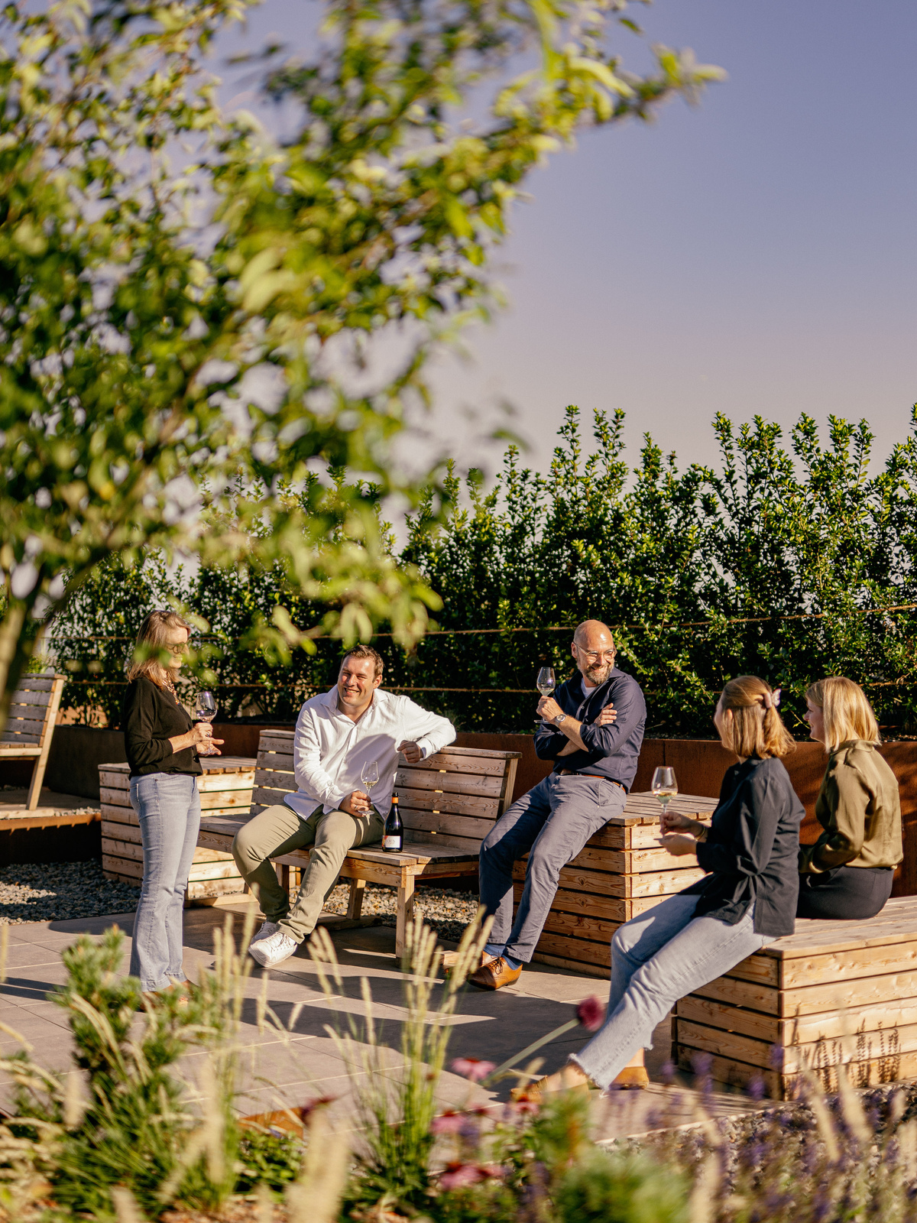


Slide 2
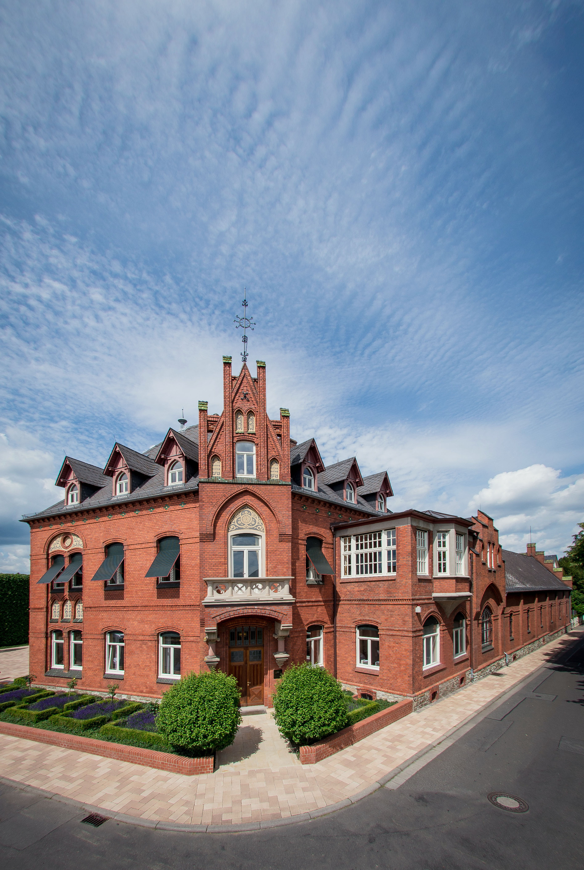
BRAND ESSENCE
OVER 150 YEARS OF HERITAGE
GERMAN CRAFTMANSHIP MEETS FRENCH SAVOIR-VIVRE
100% TRADITIONAL BOTTLE FERMENTATION
DISTINCT BY NATURE

Slide 3
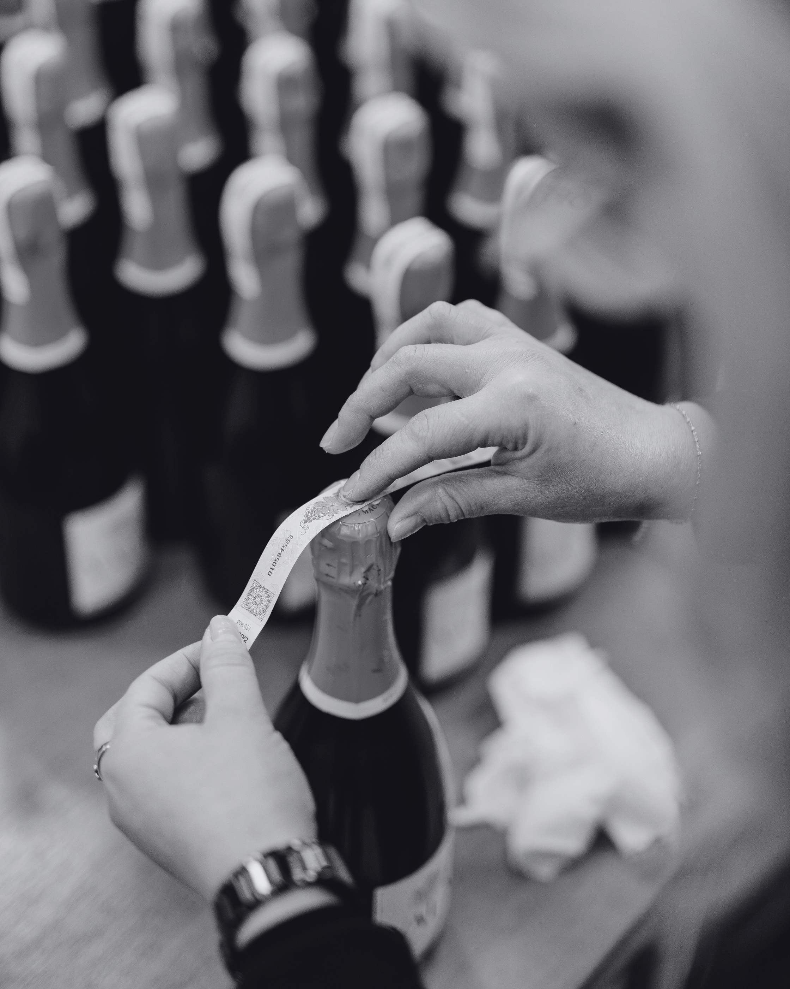
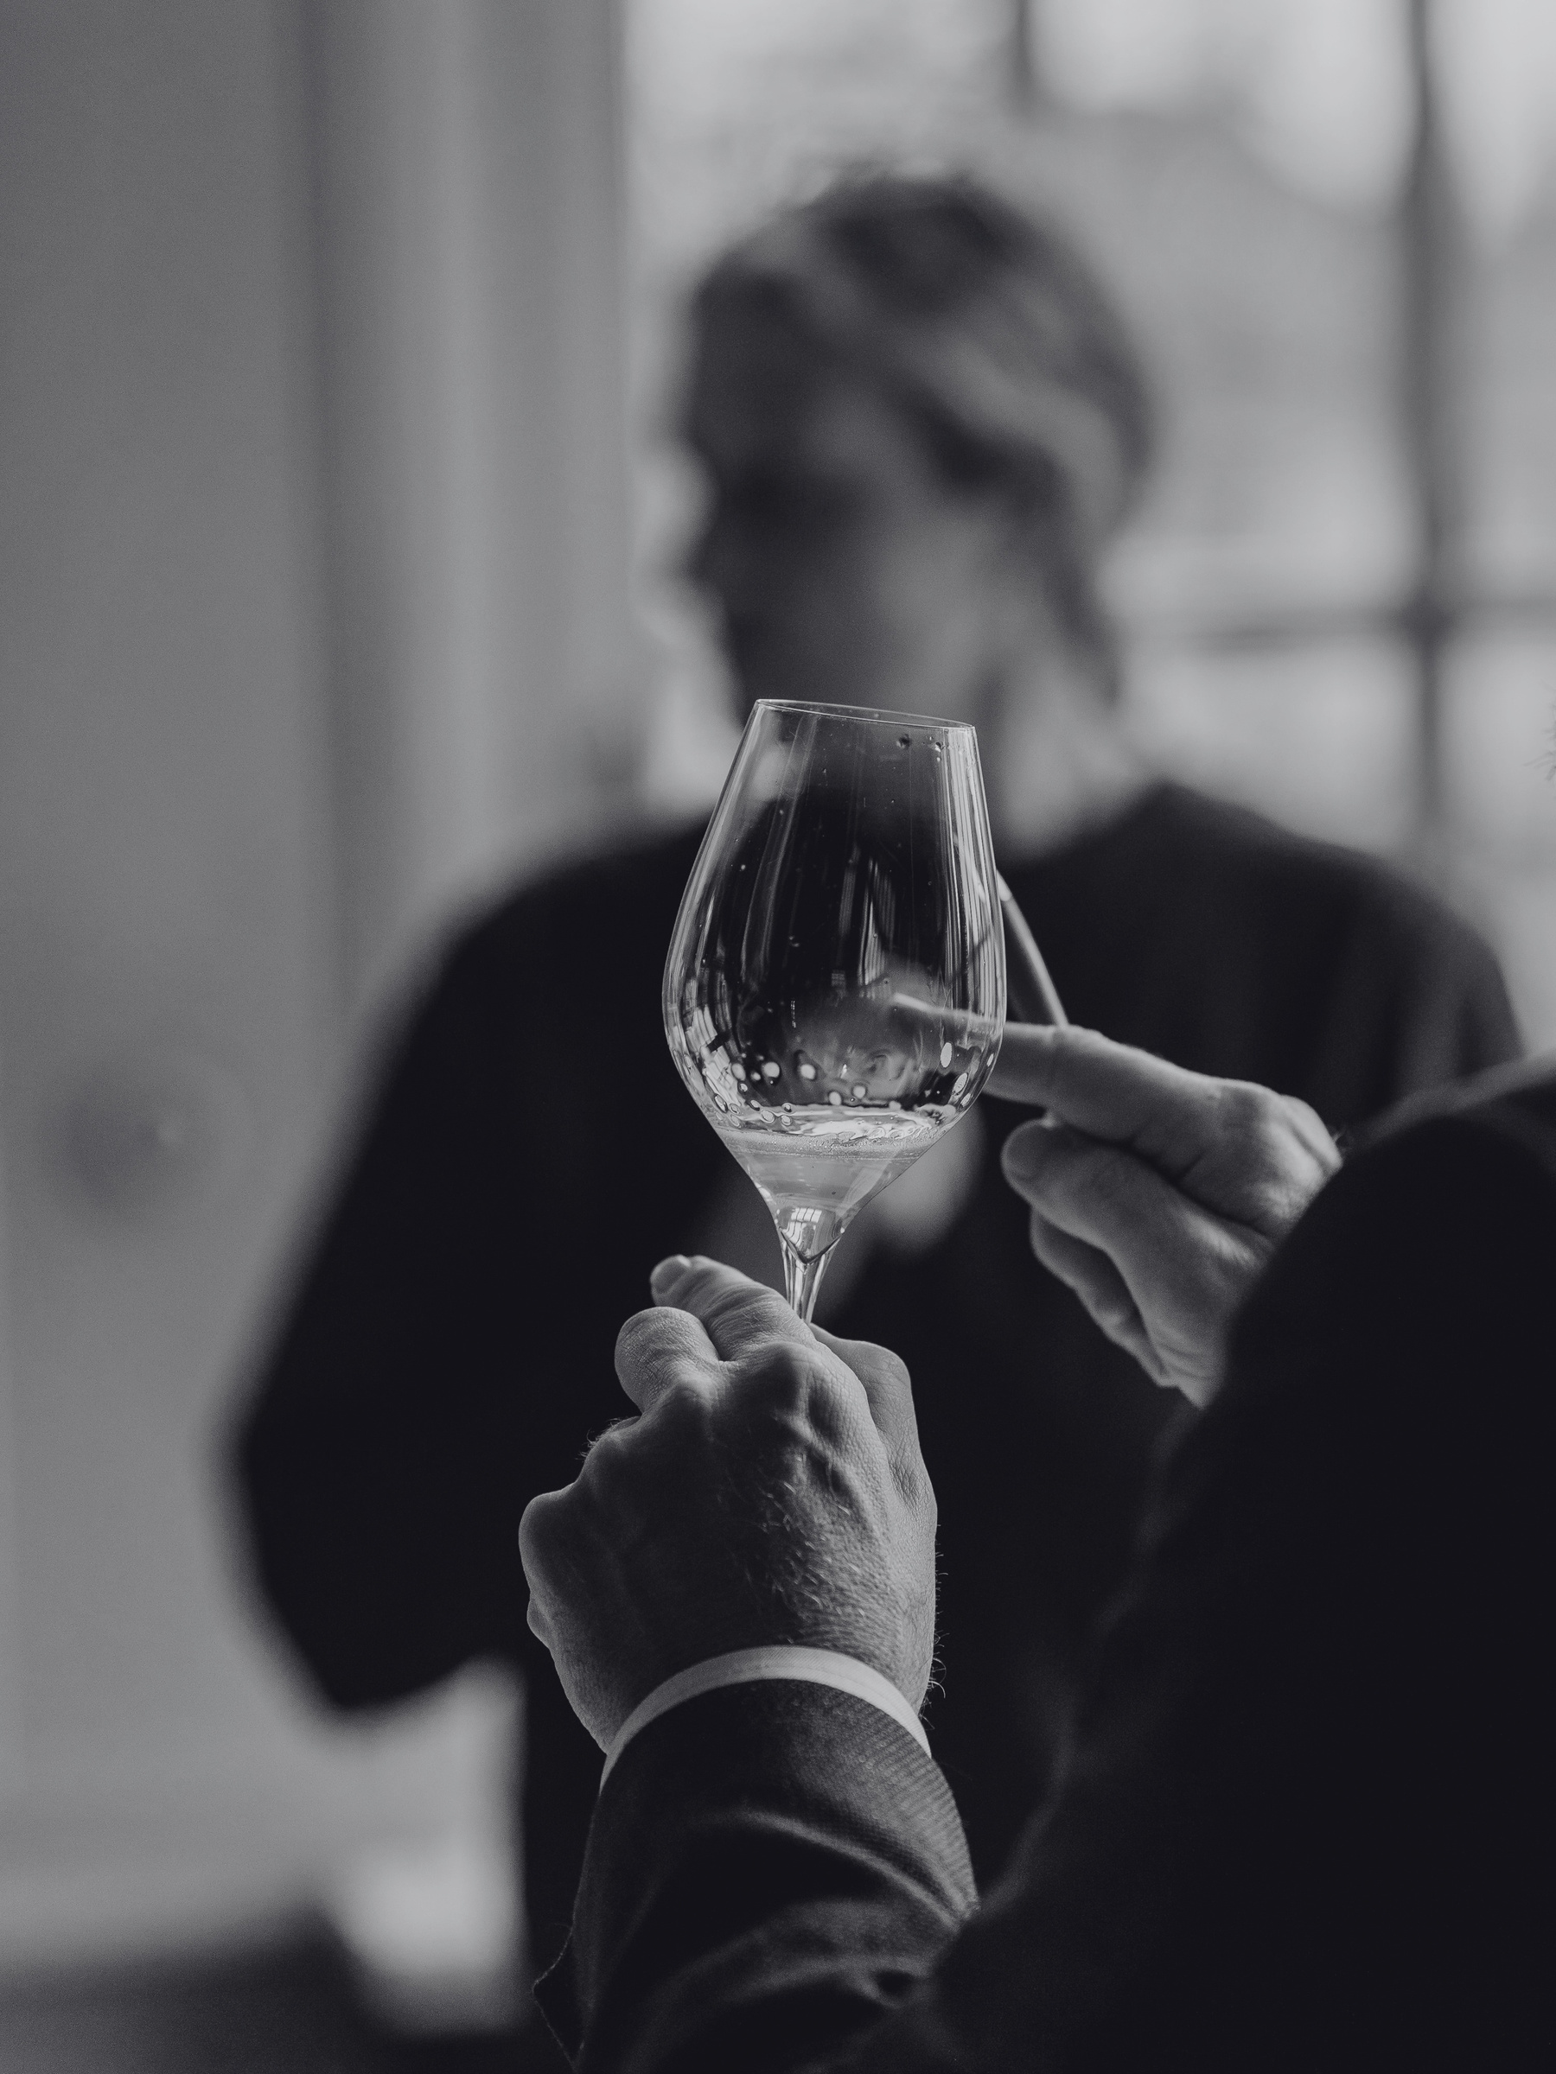
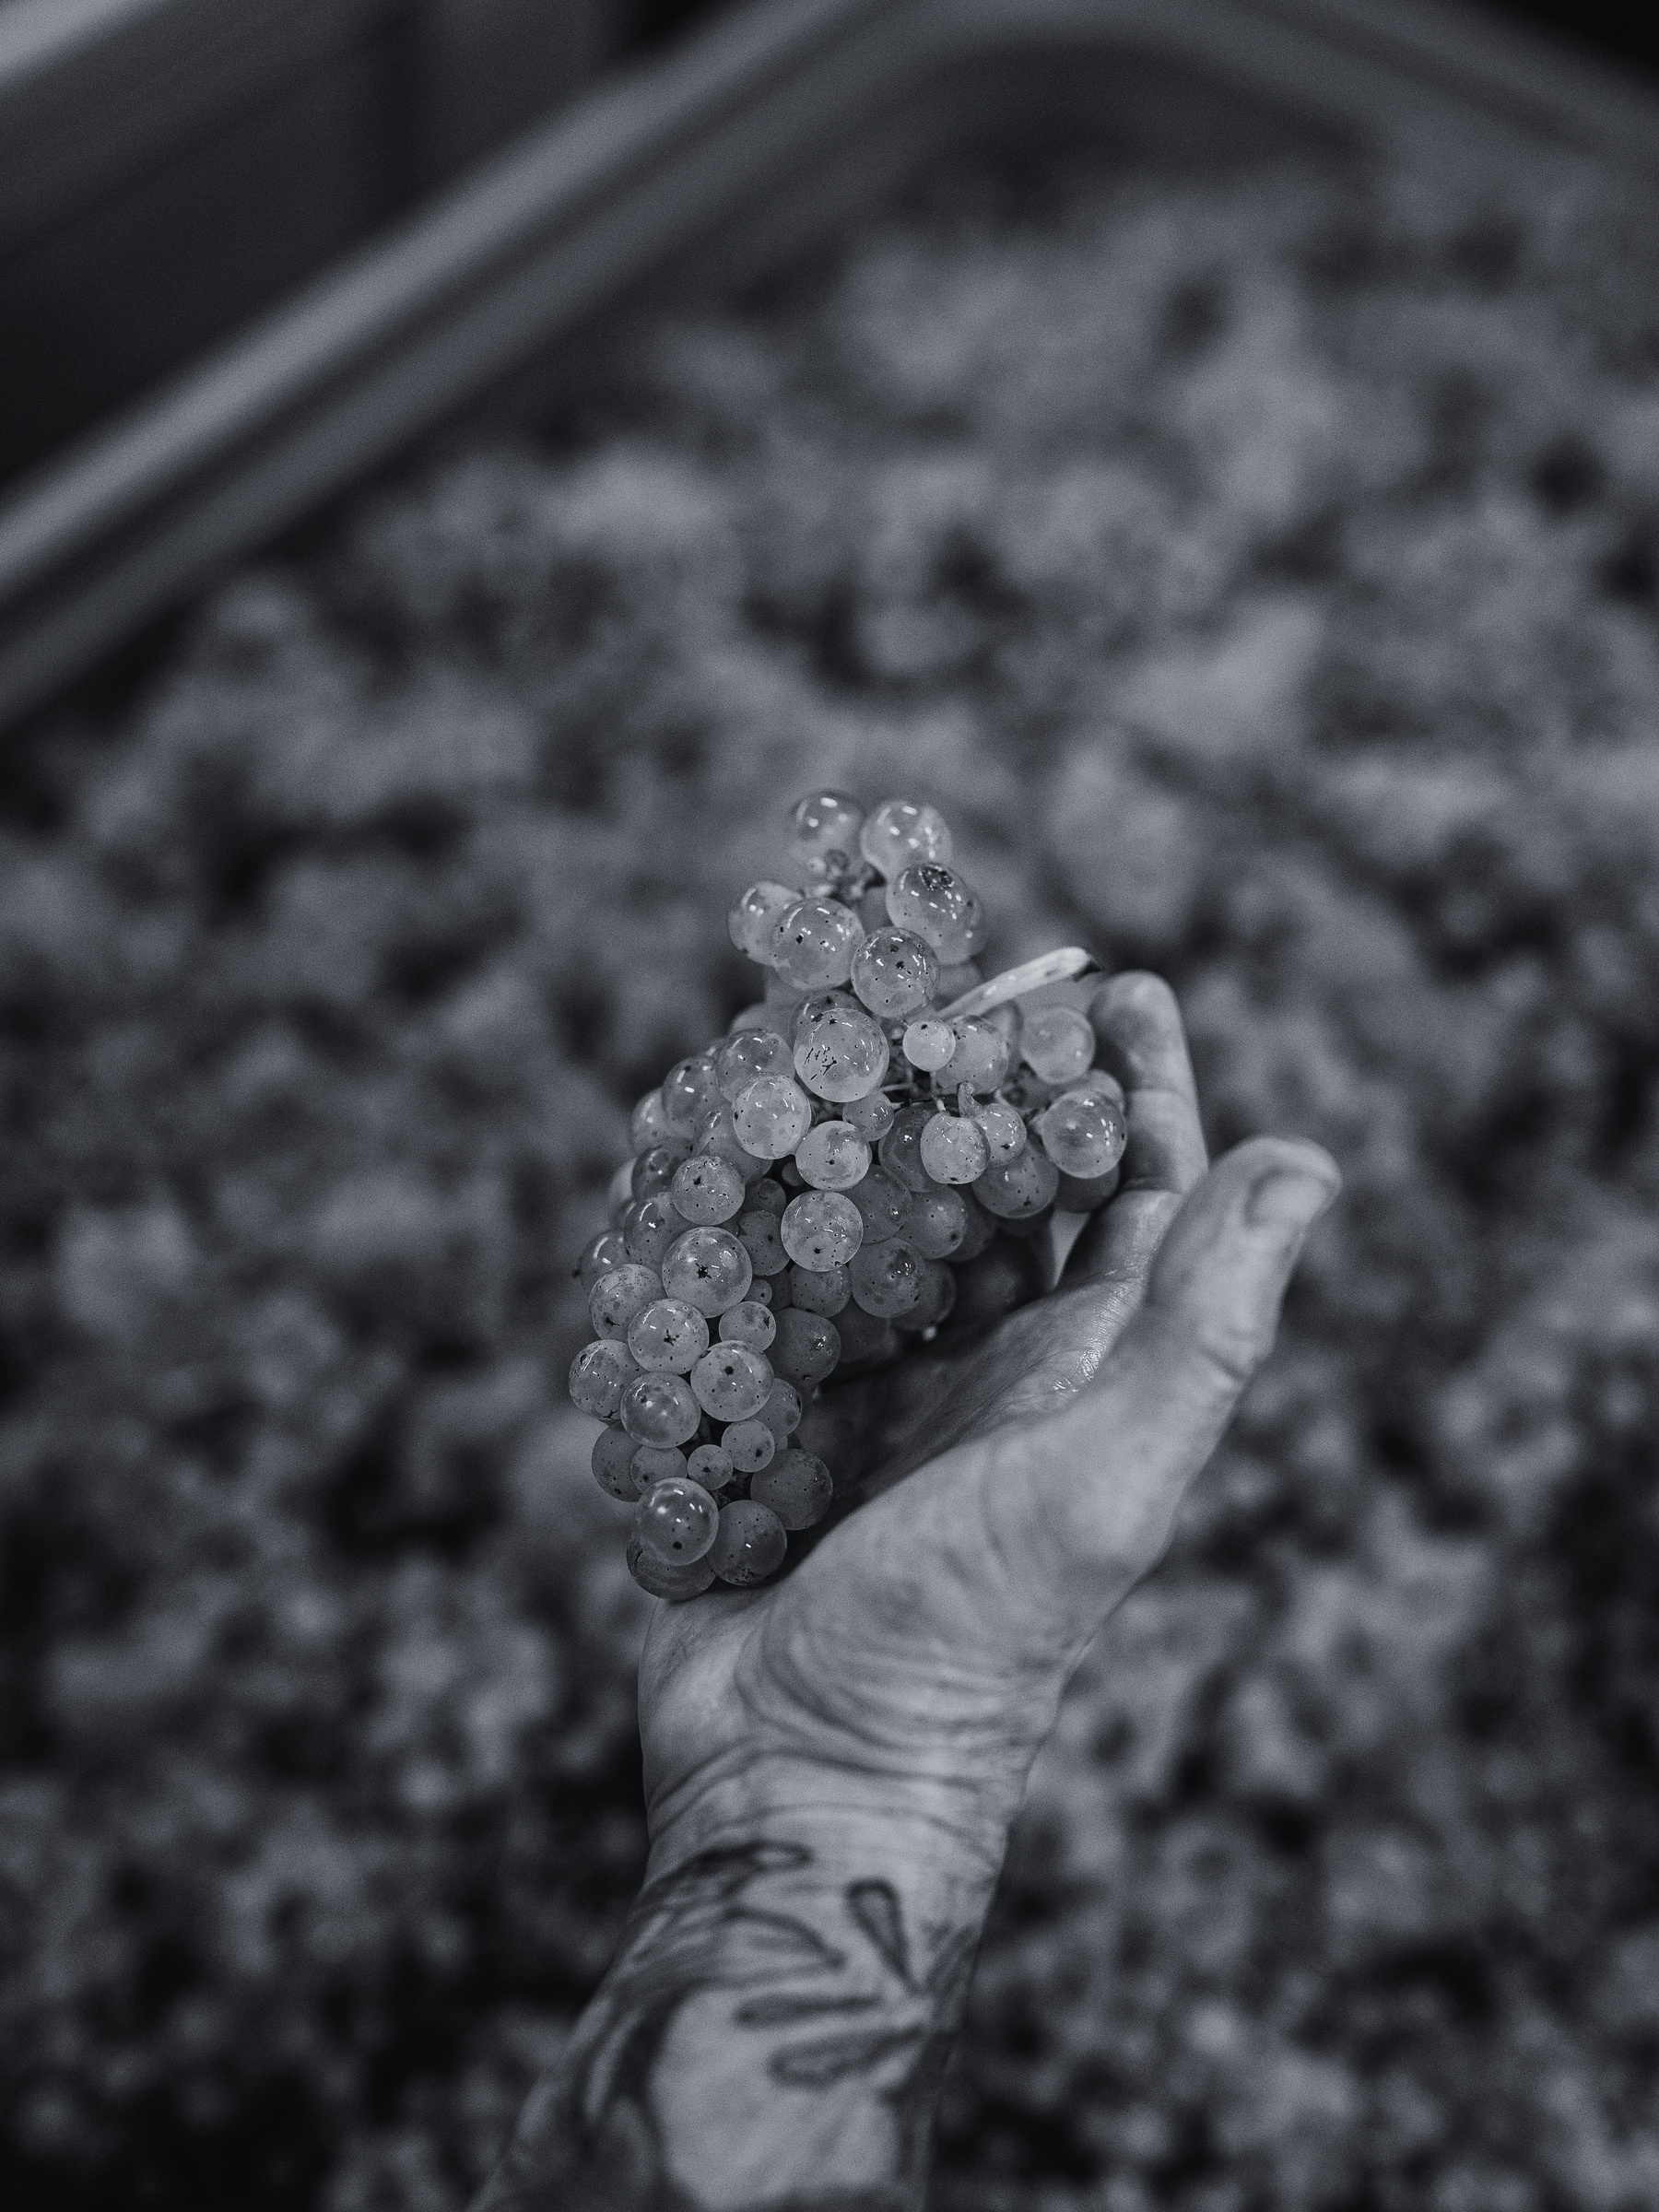
ONLY VAUX
IS VAUX
UNCOMPROMISING PREMIUM QUALITY
MASTERY OF CRAFTMANSHIP
DEEP RESPECT FOR NATURE
DRIVEN BY PASSION & INTEGRITY

Slide 4
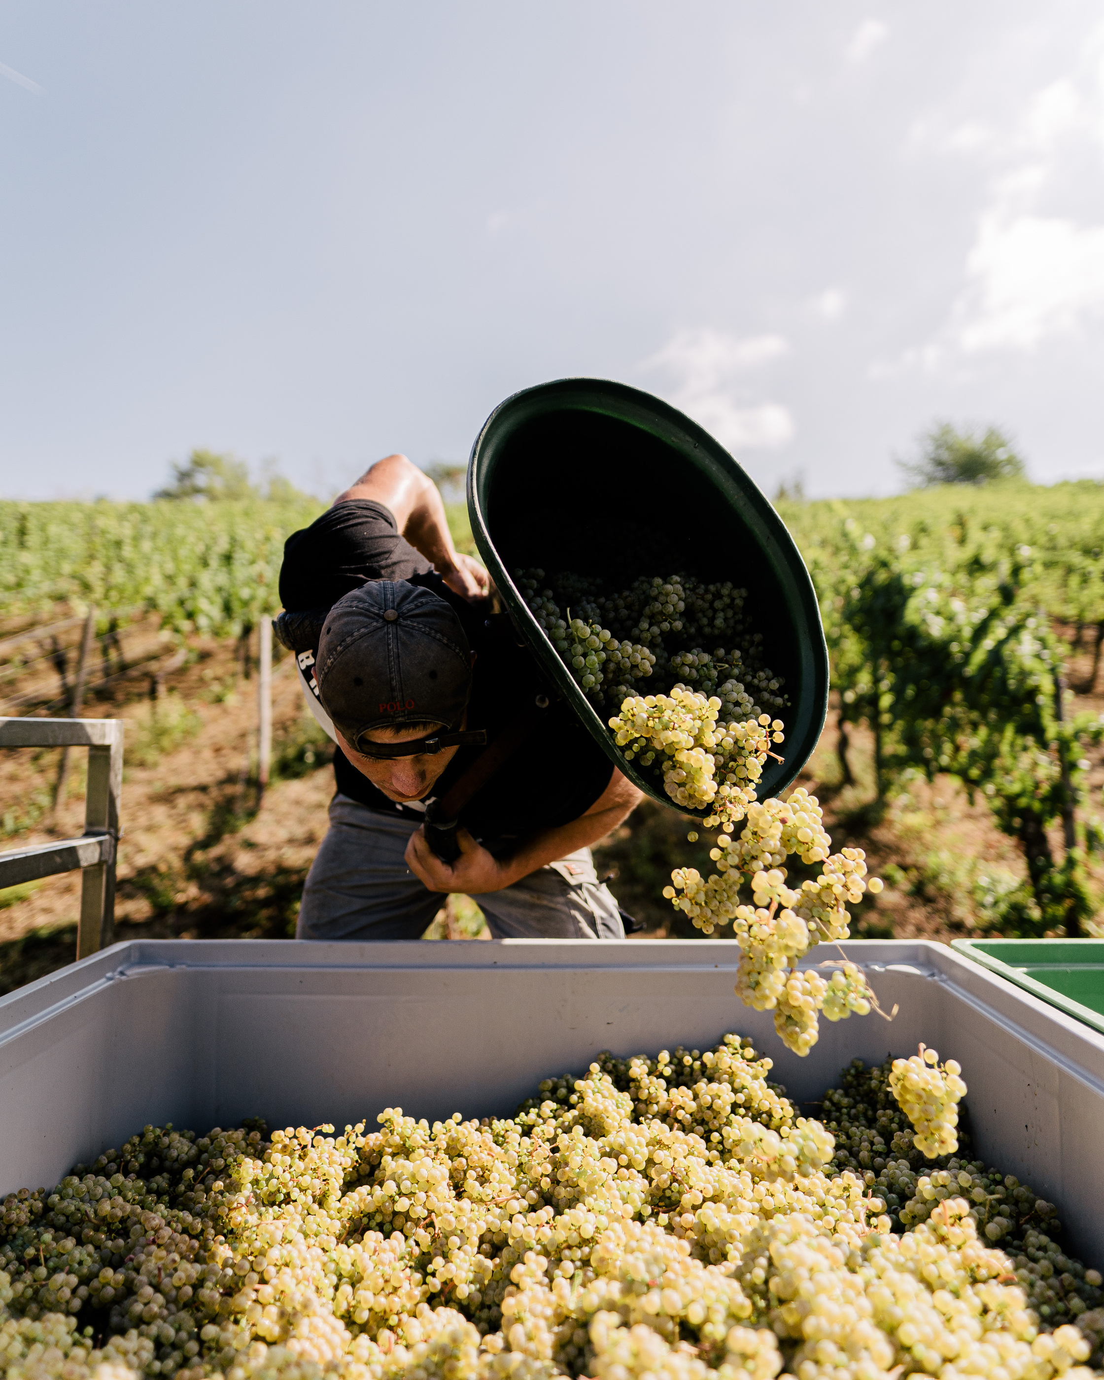
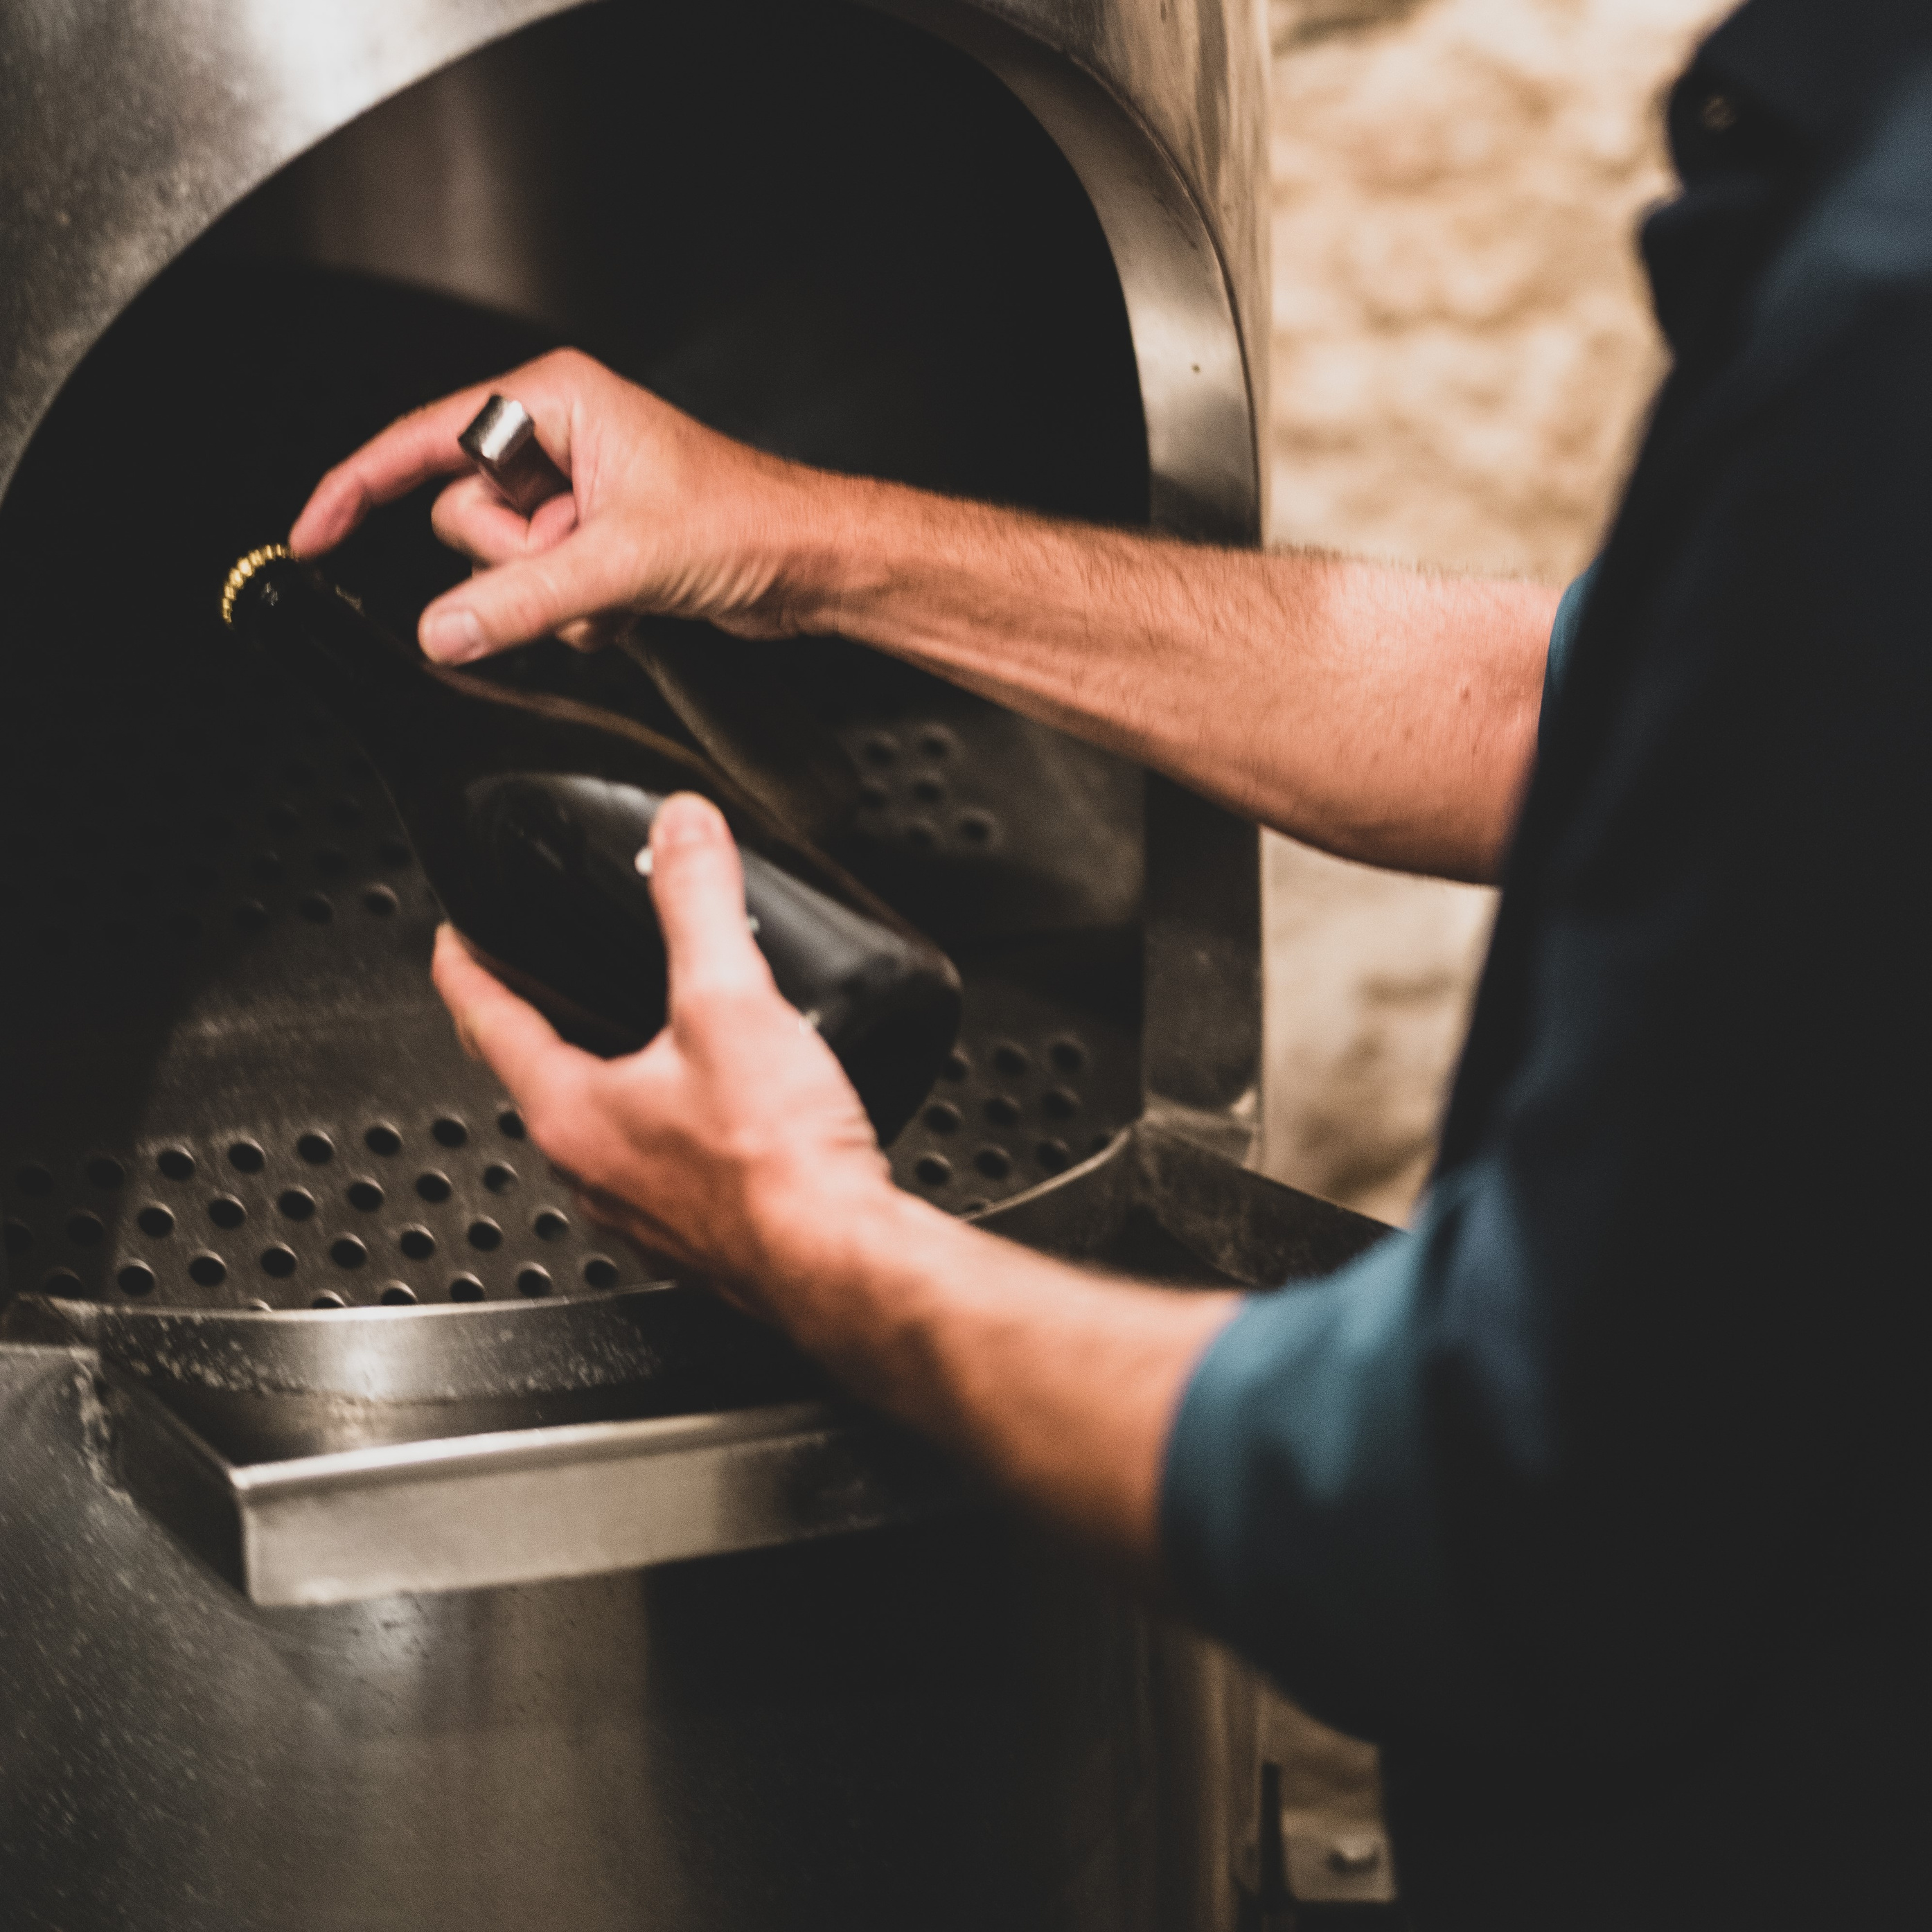
100% TRADITIONAL METHOD
100% ESTATE-DRIVEN IDENTITY
100% VINTAGE & BRUT
100% GERMAN BASE WINES
NO CONCESSIONS. NO DIVERSIONS.

Slide 5
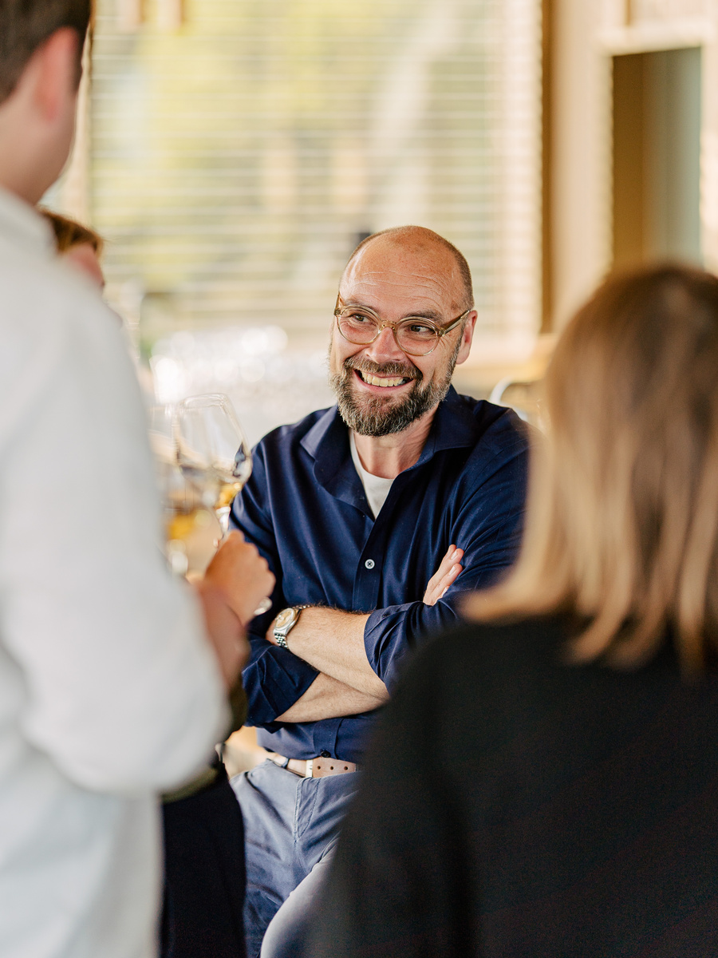
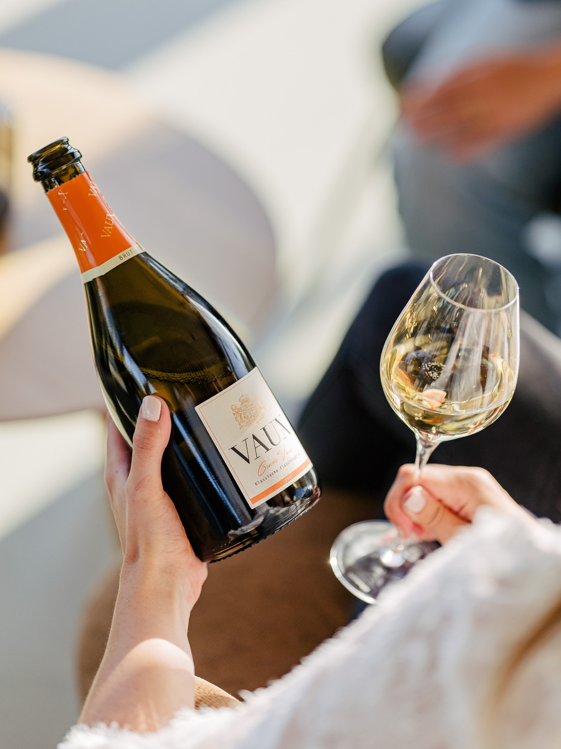
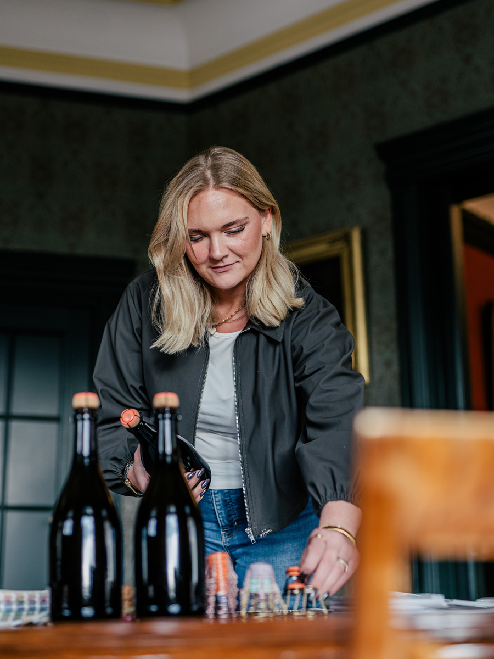
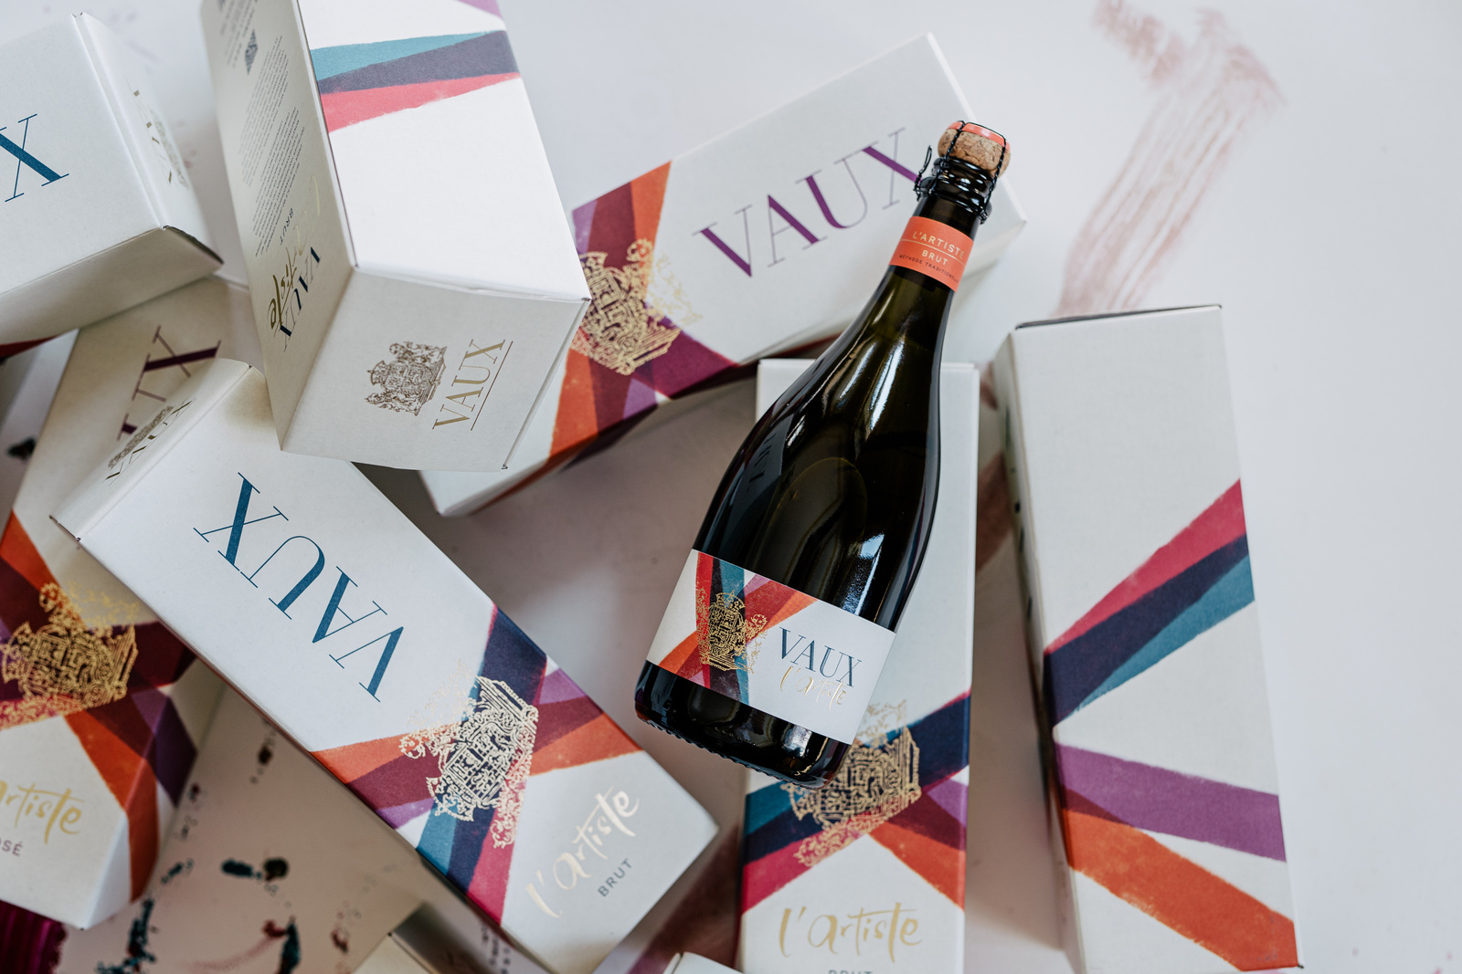
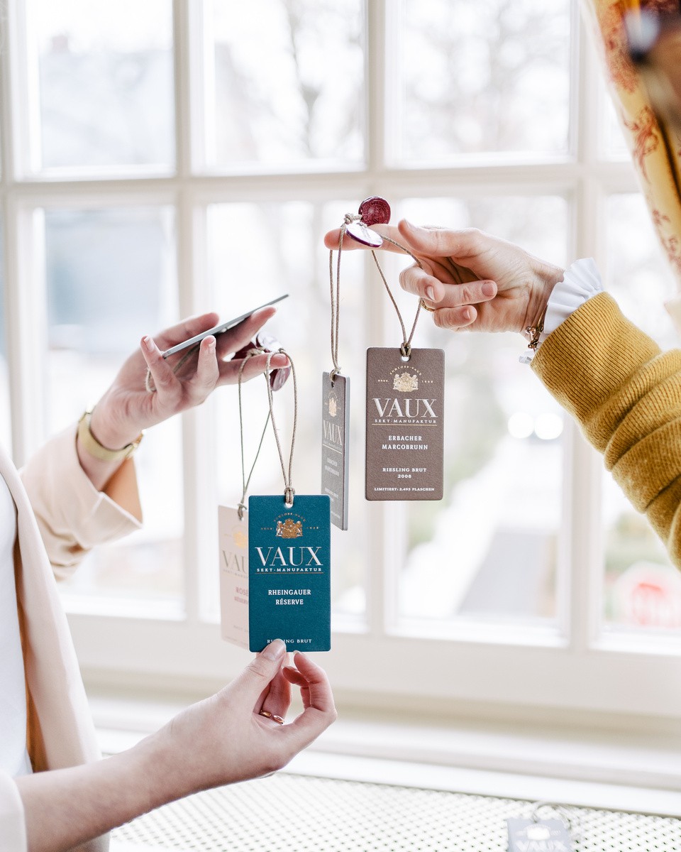
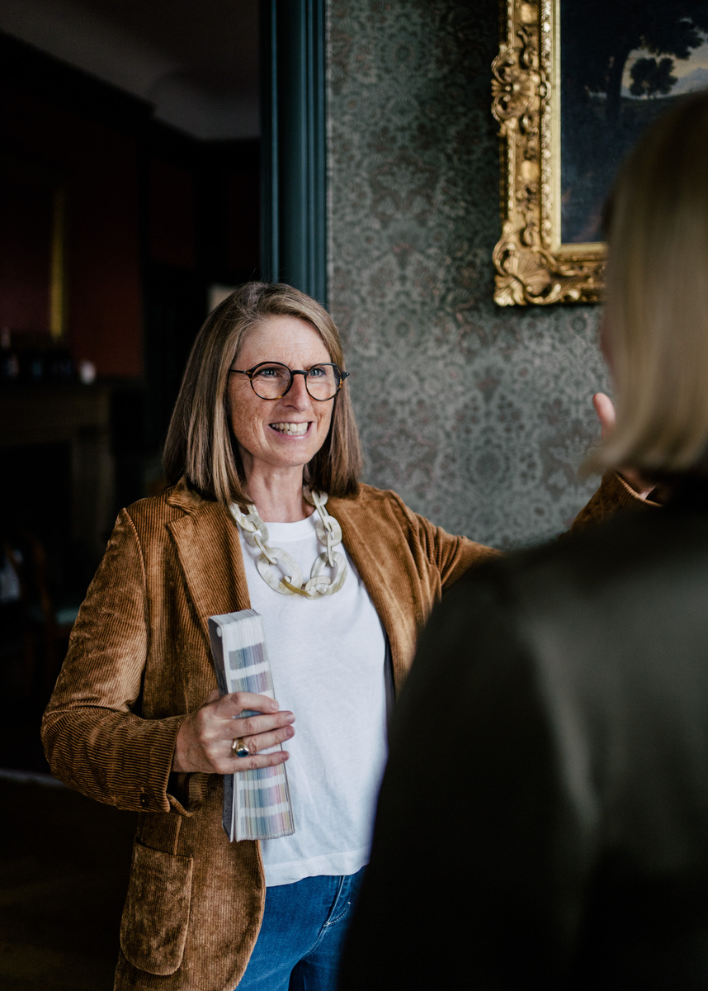
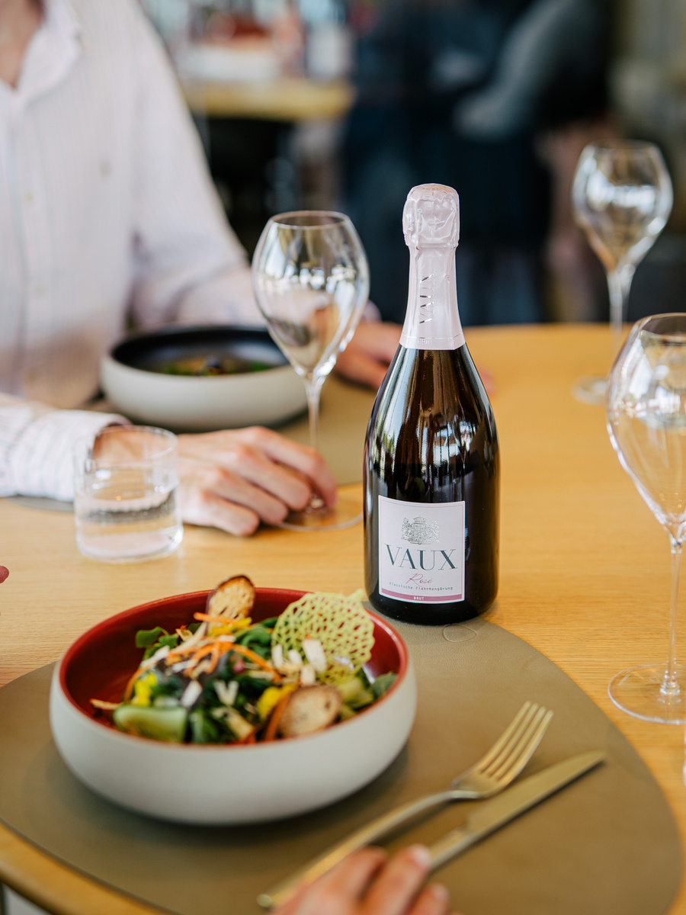
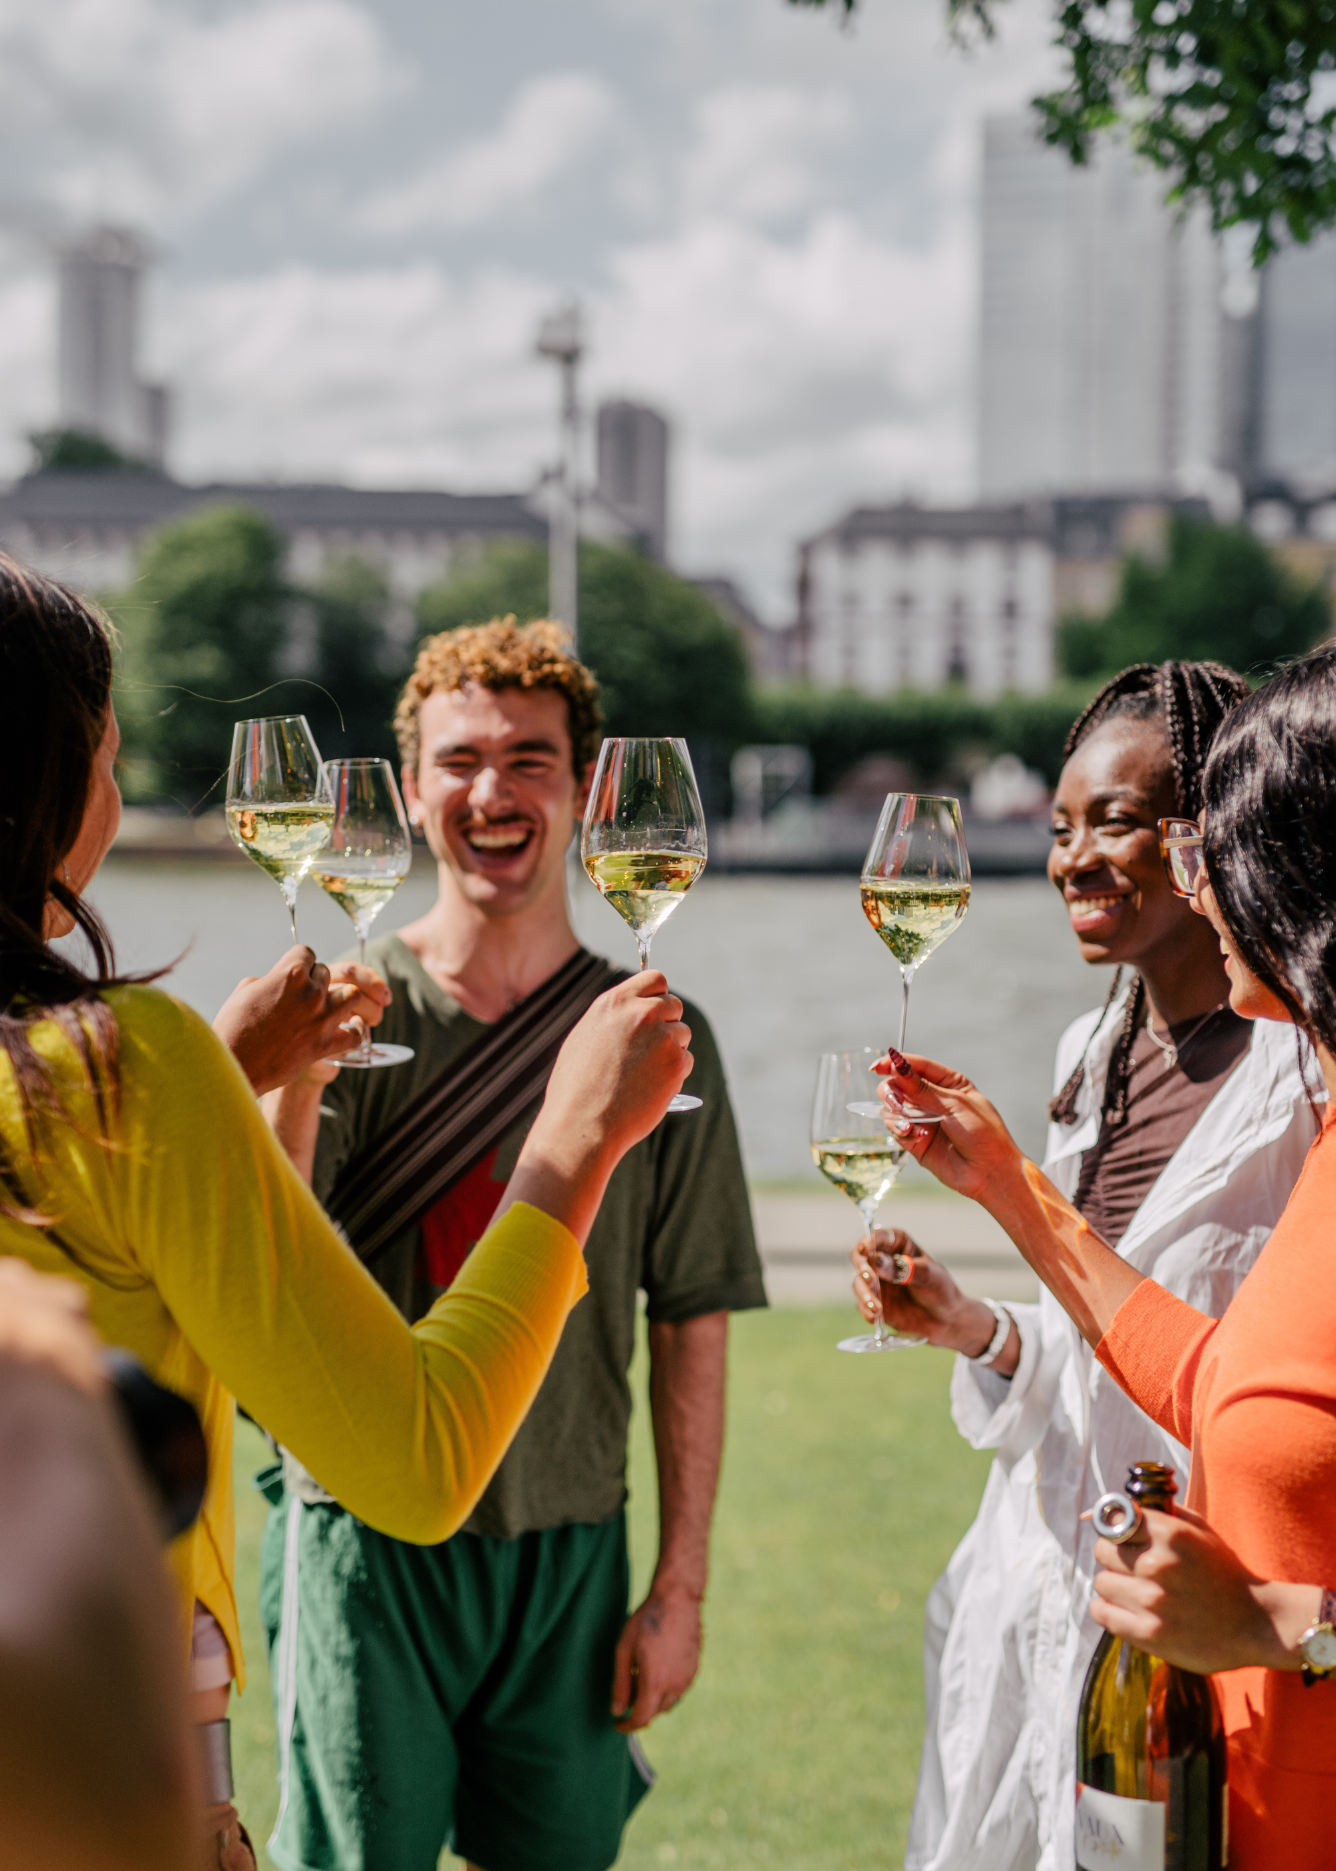
A SYMBOL OF APPRECIATION AND DISTINCTION
SHARED PLEASURE.
PERSONAL INDULGENCE.
REFINING THE EVERYDAY
ELEVATING LIFE´S MOST MEANINGFUL MOMENTS

Slide 6
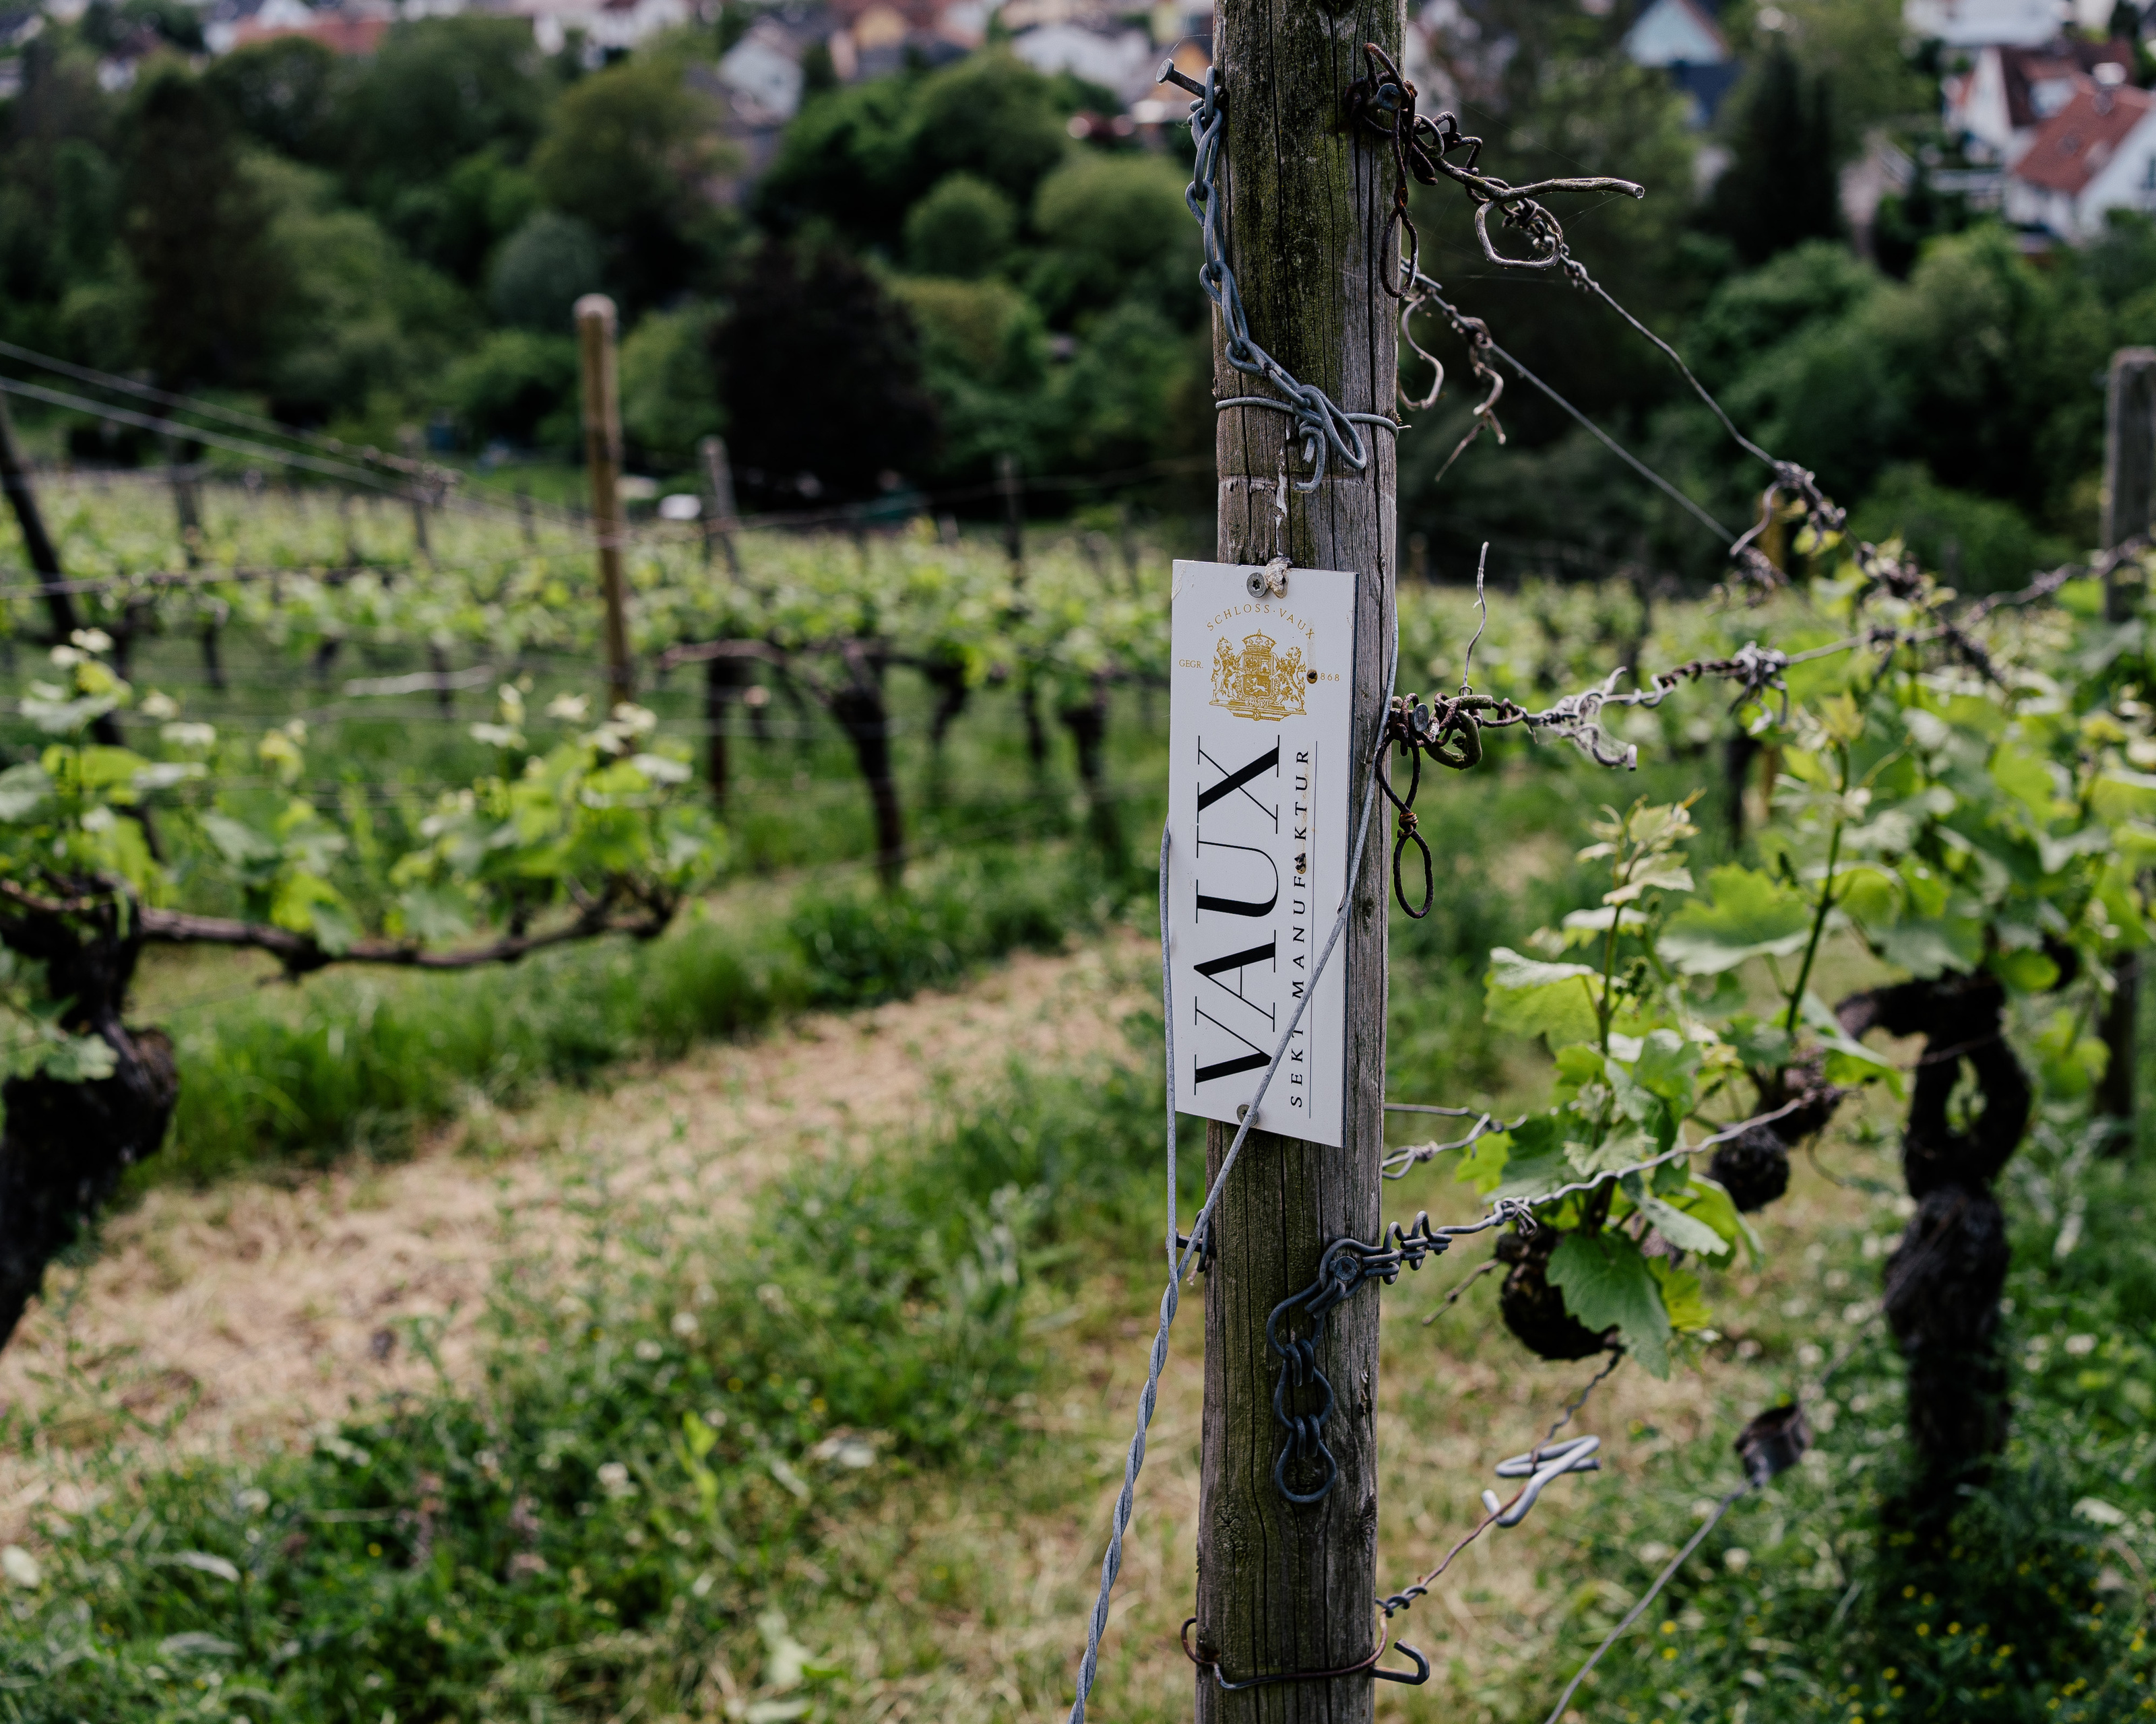
POSITIONING
AMONG GERMANY´S LEADING PREMIUM SPARKLINGHOUSES
SINGULAR FOCUS, UNMATCHED SPECIALIZATION
LIMITED PRODUCTION, EXCEPTIONAL PRECISION
TRUSTET PARTNERSHIPS IN TOP TERROIRS

Slide 7
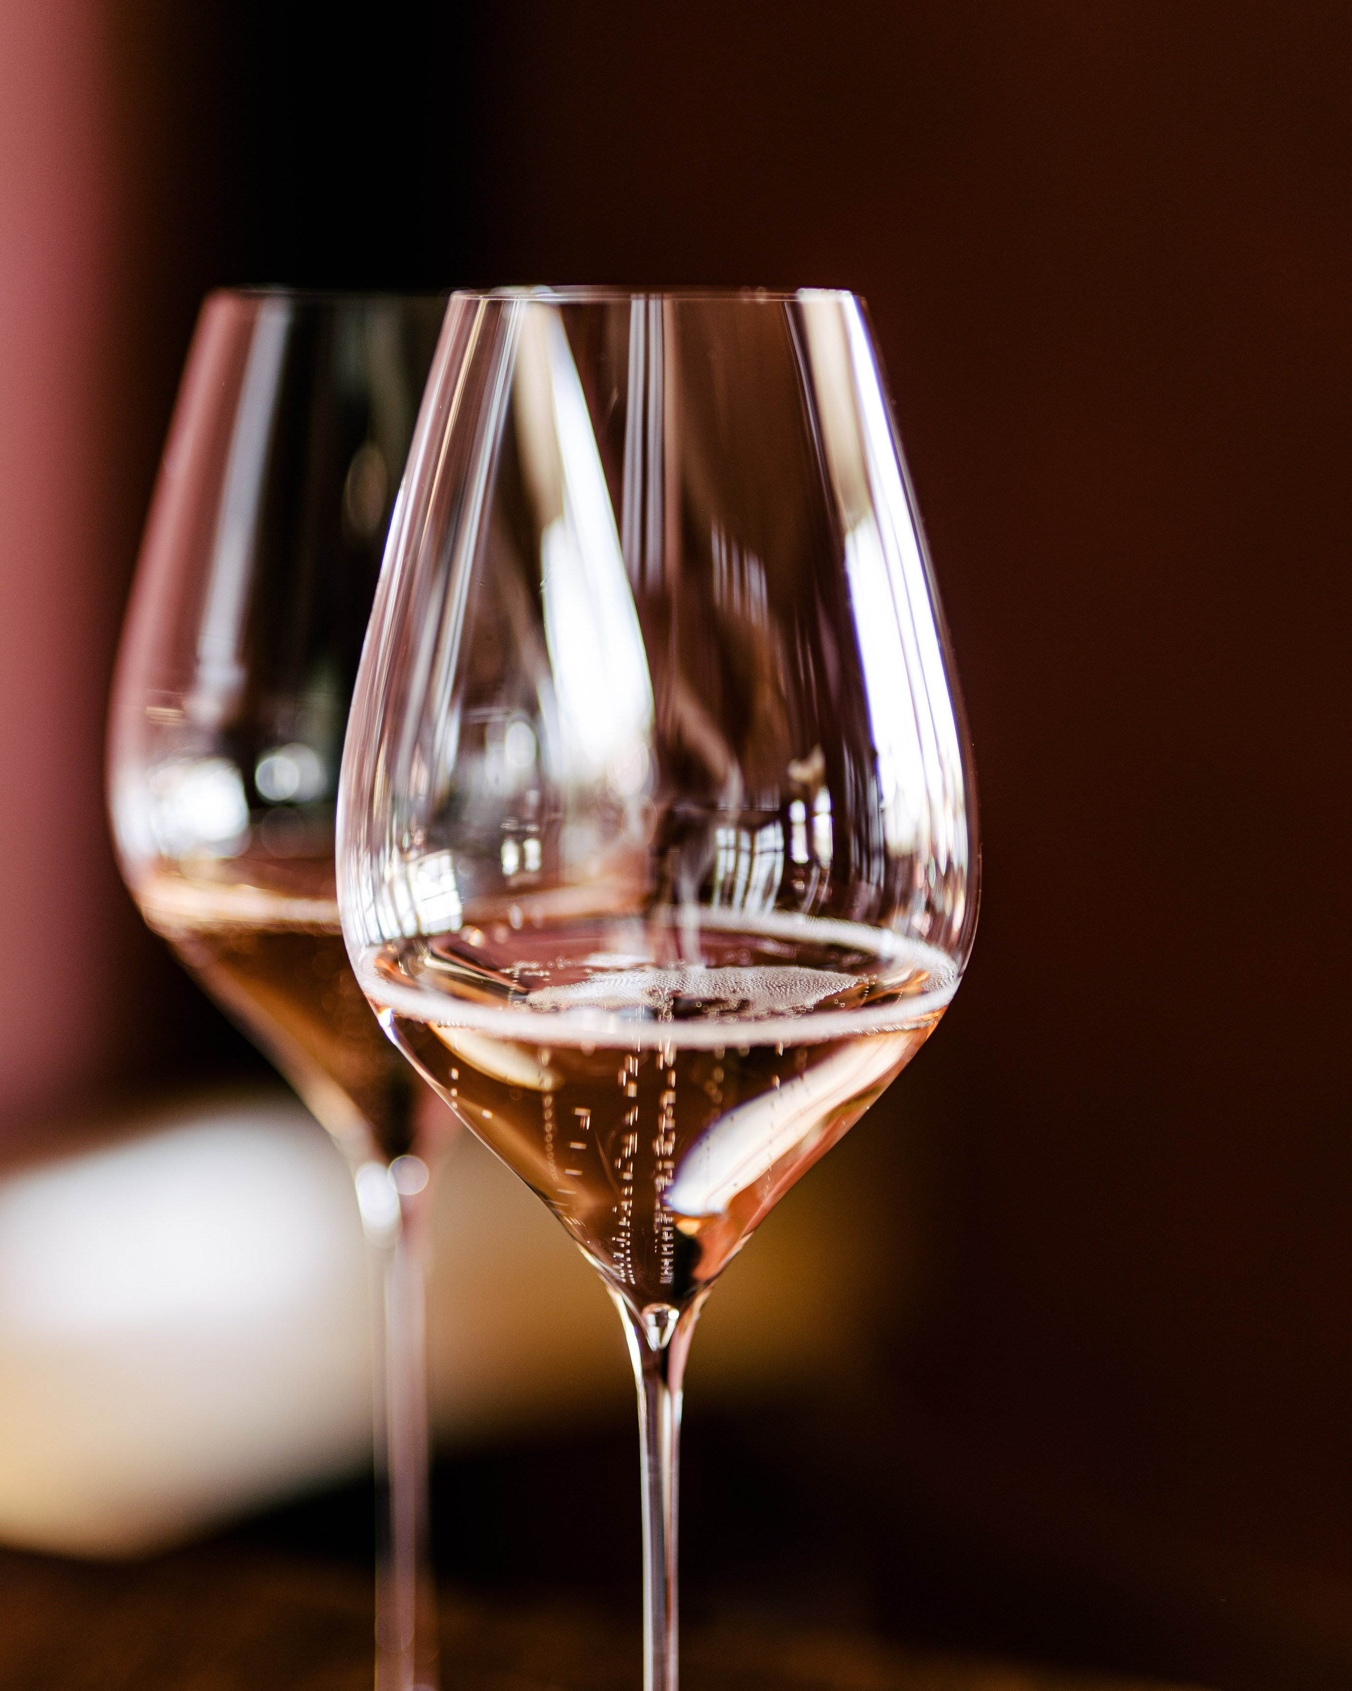
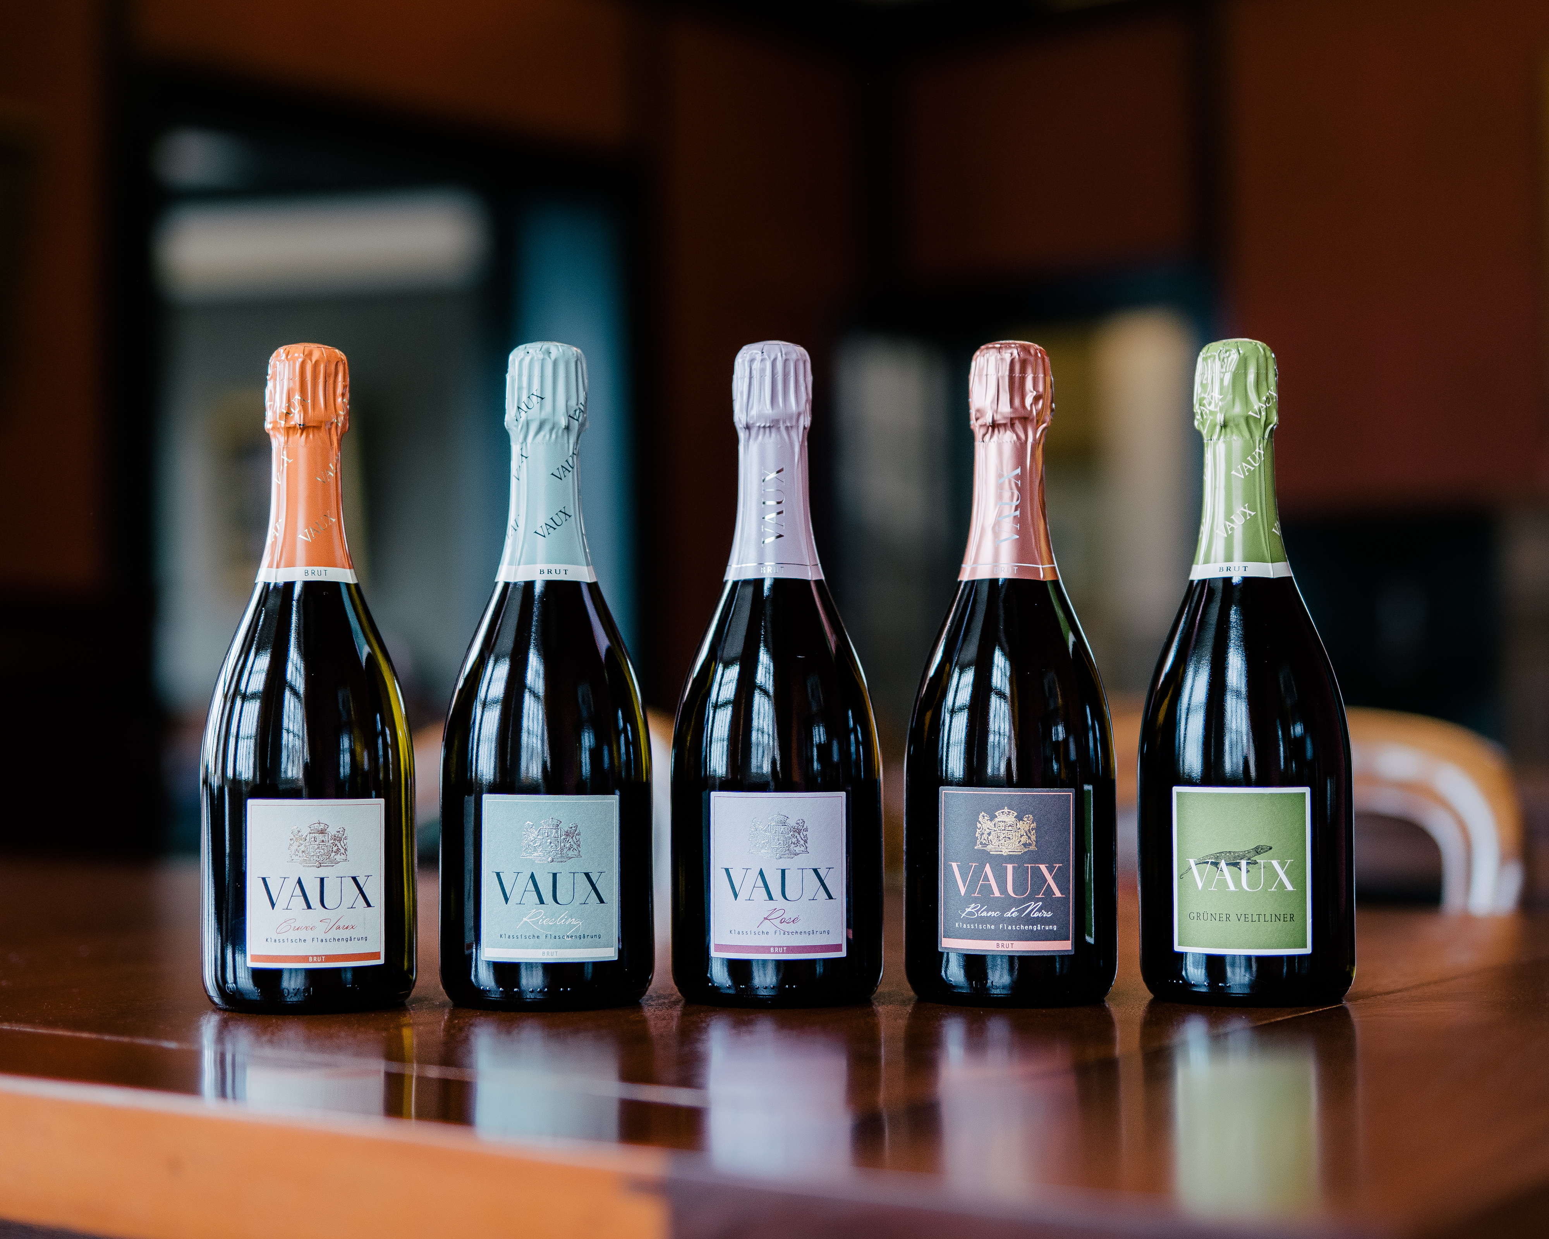
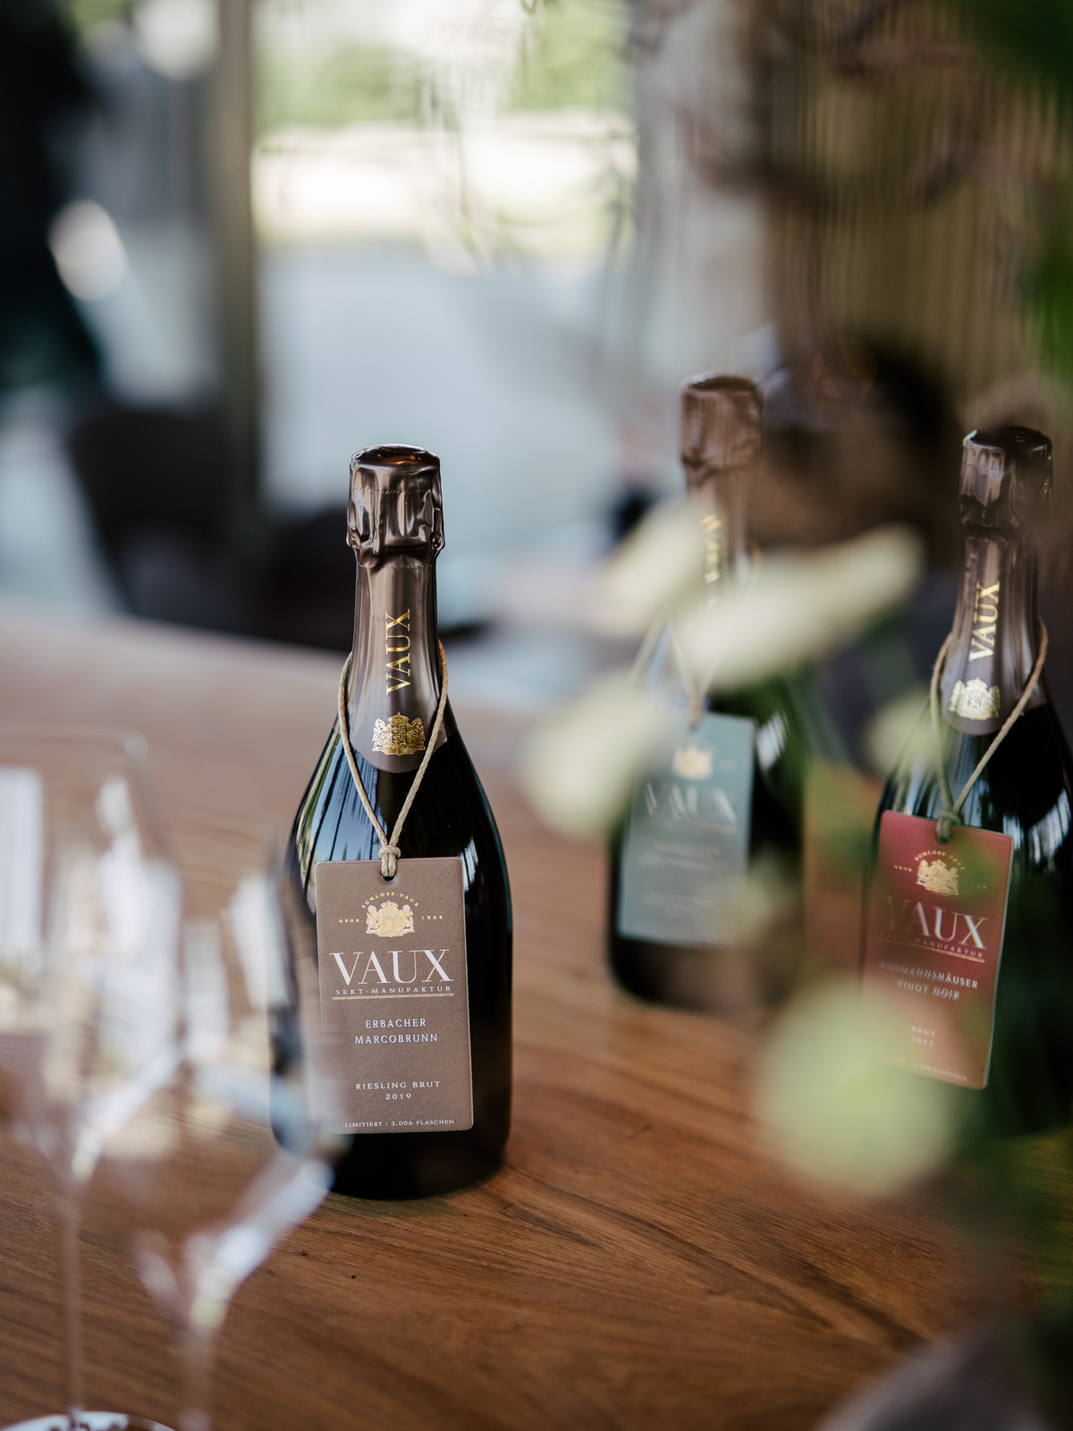
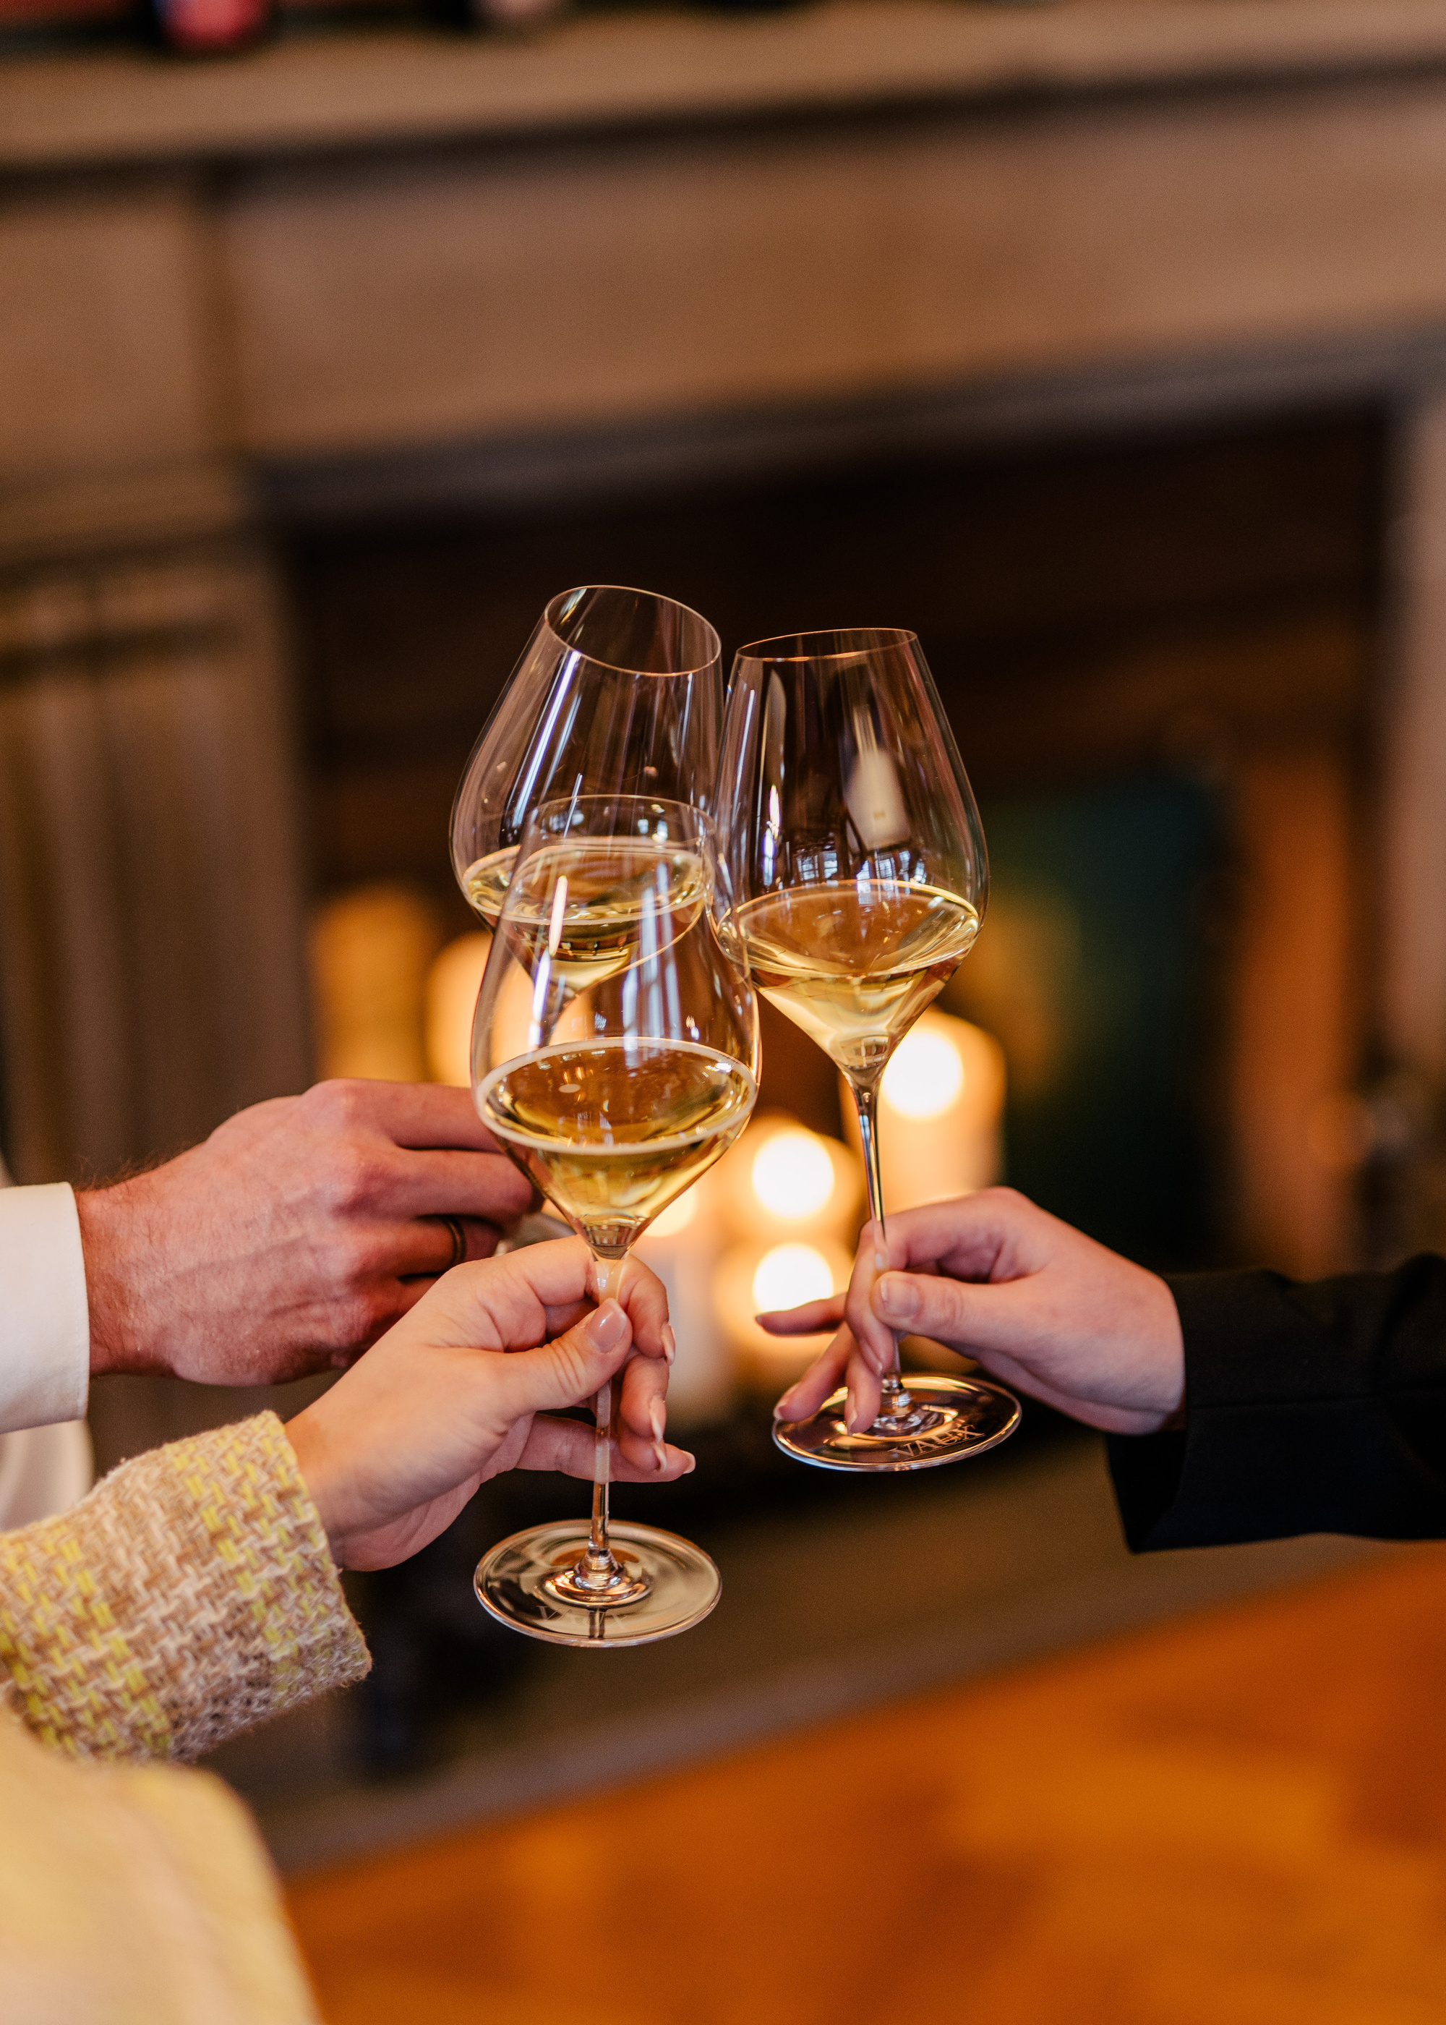
DISTINCTIVE IN CHARACTER
CONSISTENLY EXCEPTIONAL
ELEGANT BY DESIGN

Slide 8
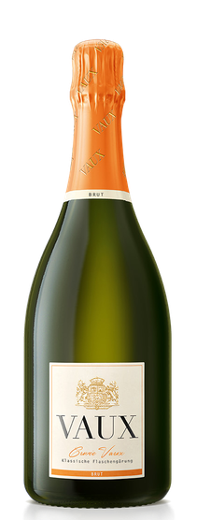
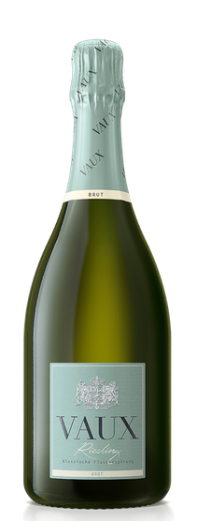
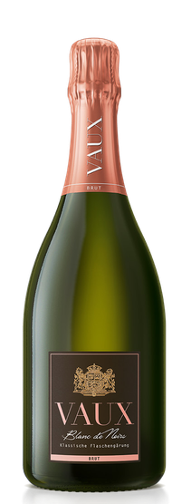
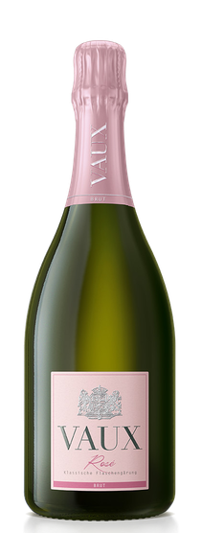
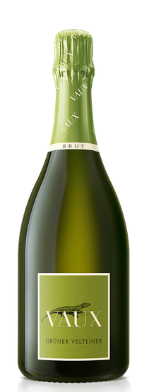
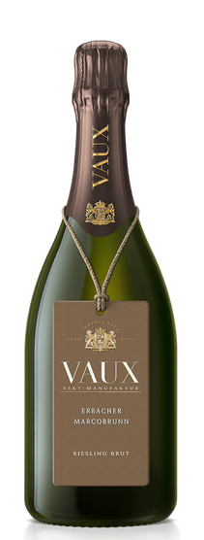
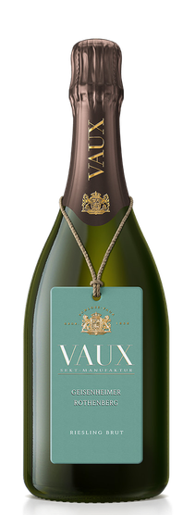
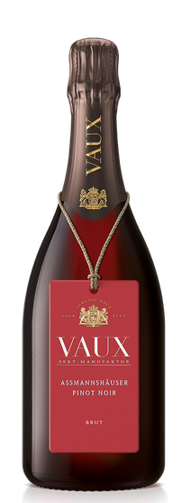
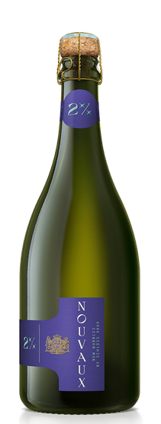
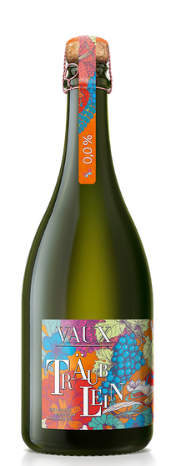
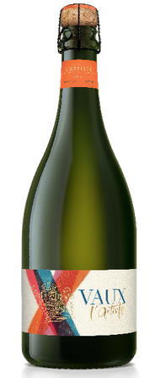
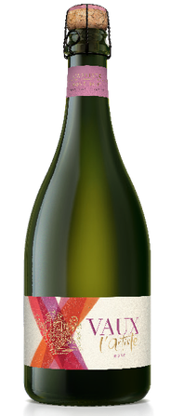
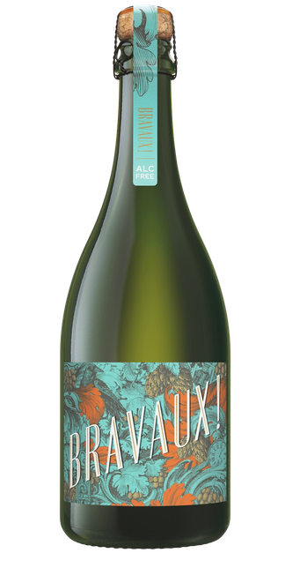
MISSION
BRINGING VAUX TO LIFE THROUGH PRODUCT, STORY AND EXPERIENCE
CREATING MOEMNTS OF JOY, ELEGANCE AND APPRECIATION

Slide 9
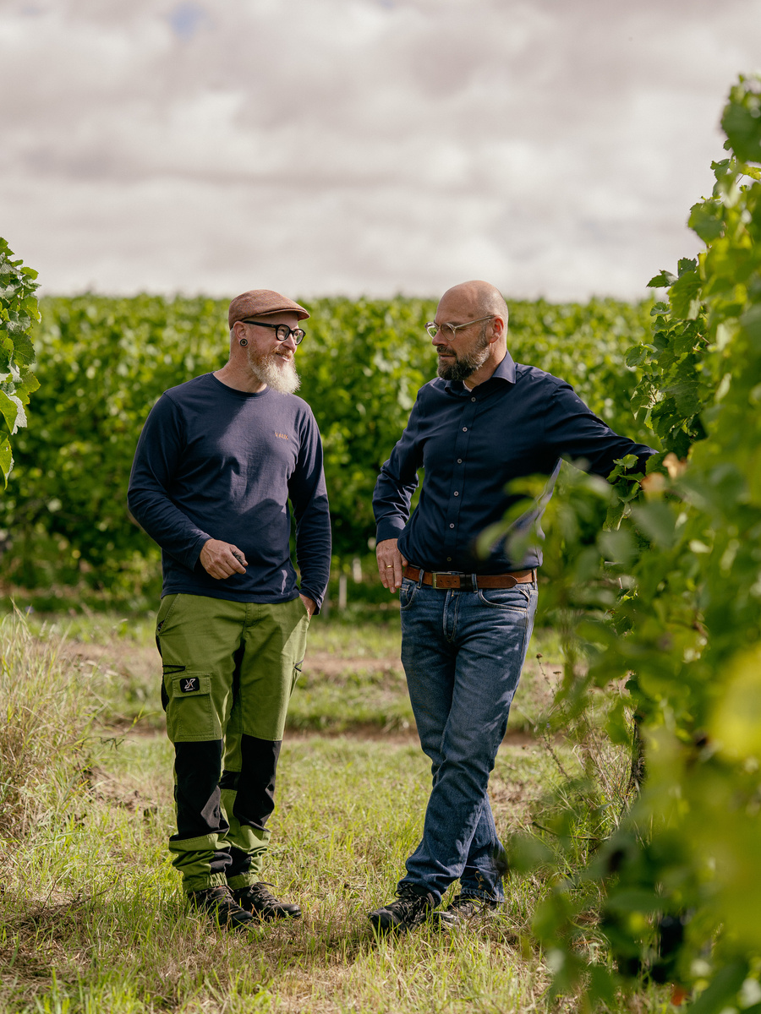
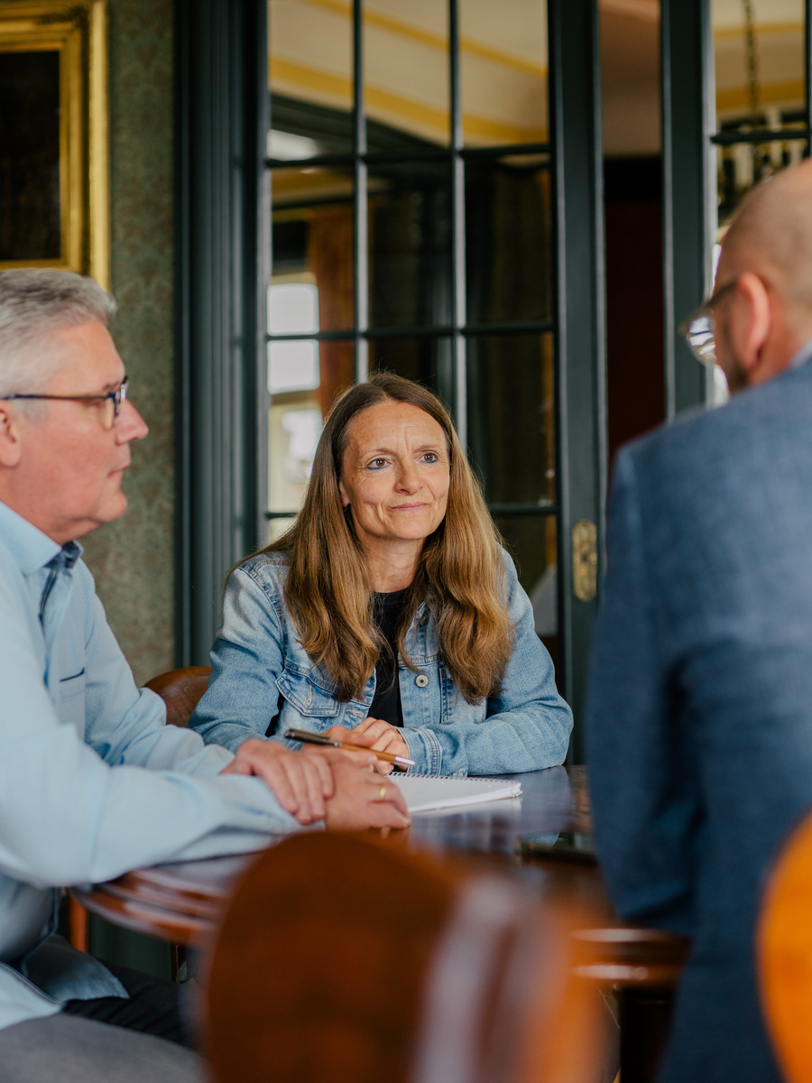
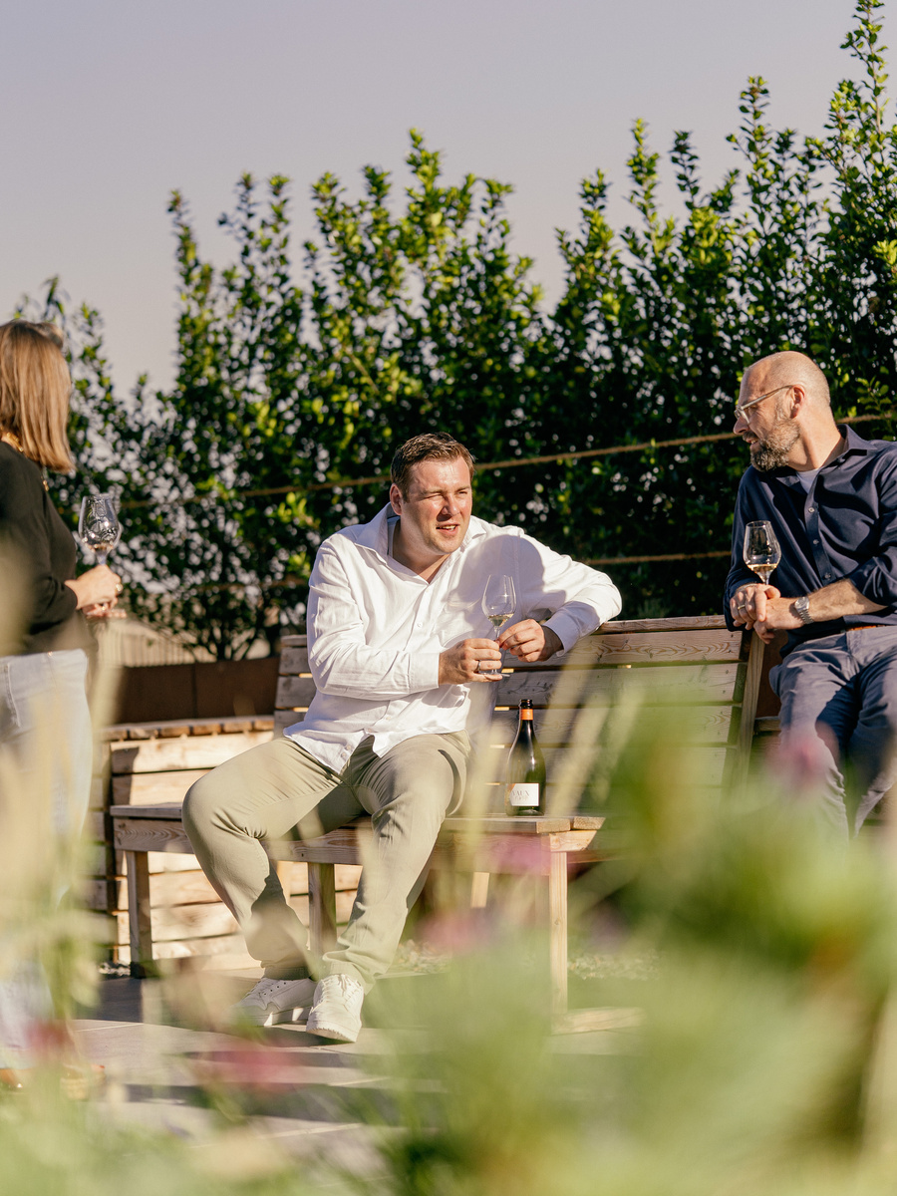
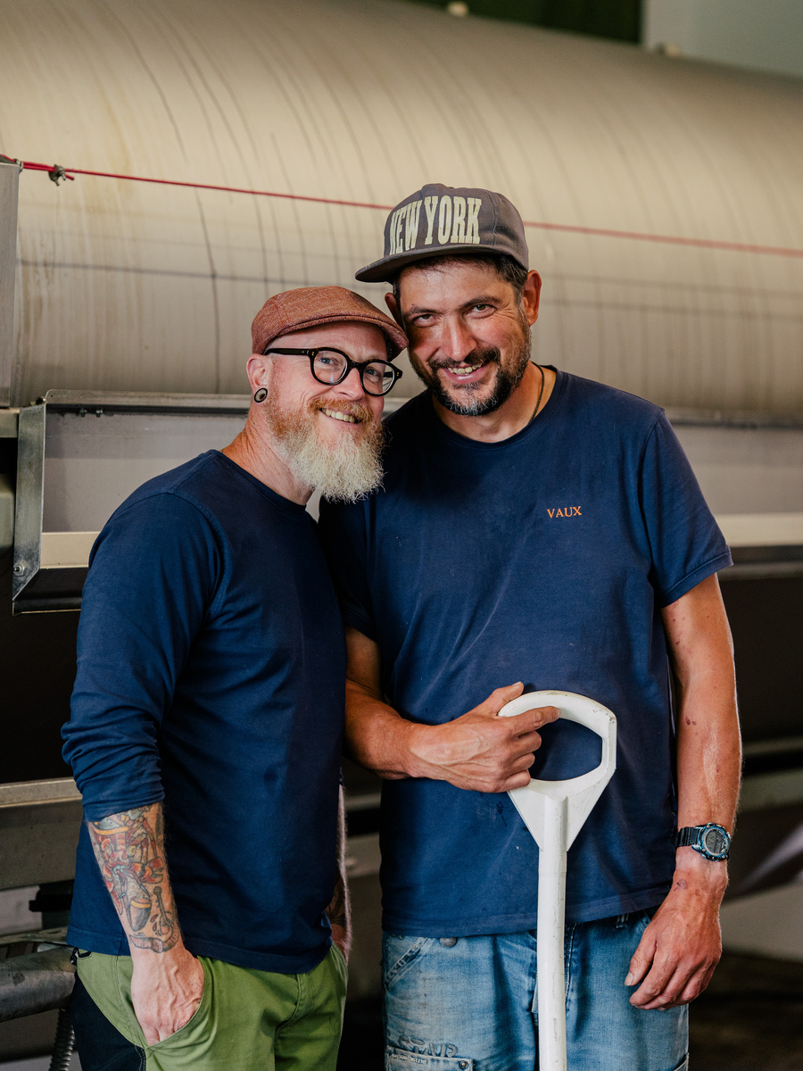
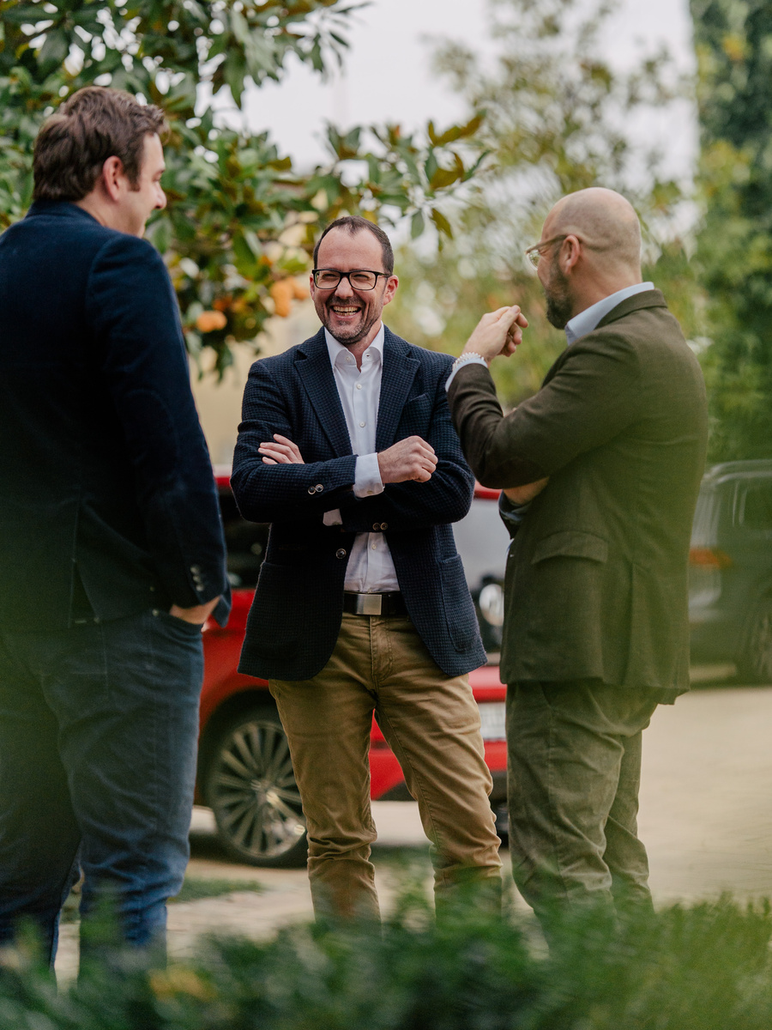
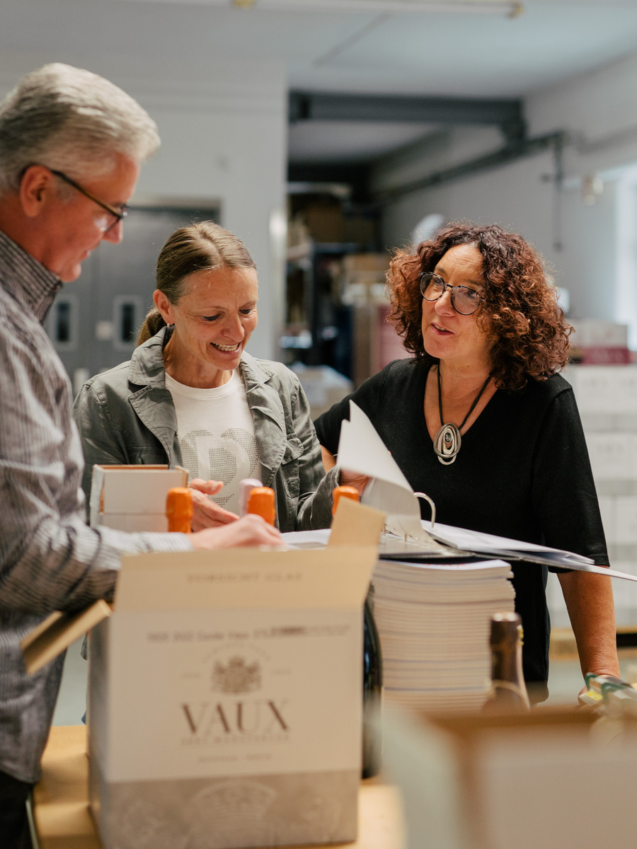
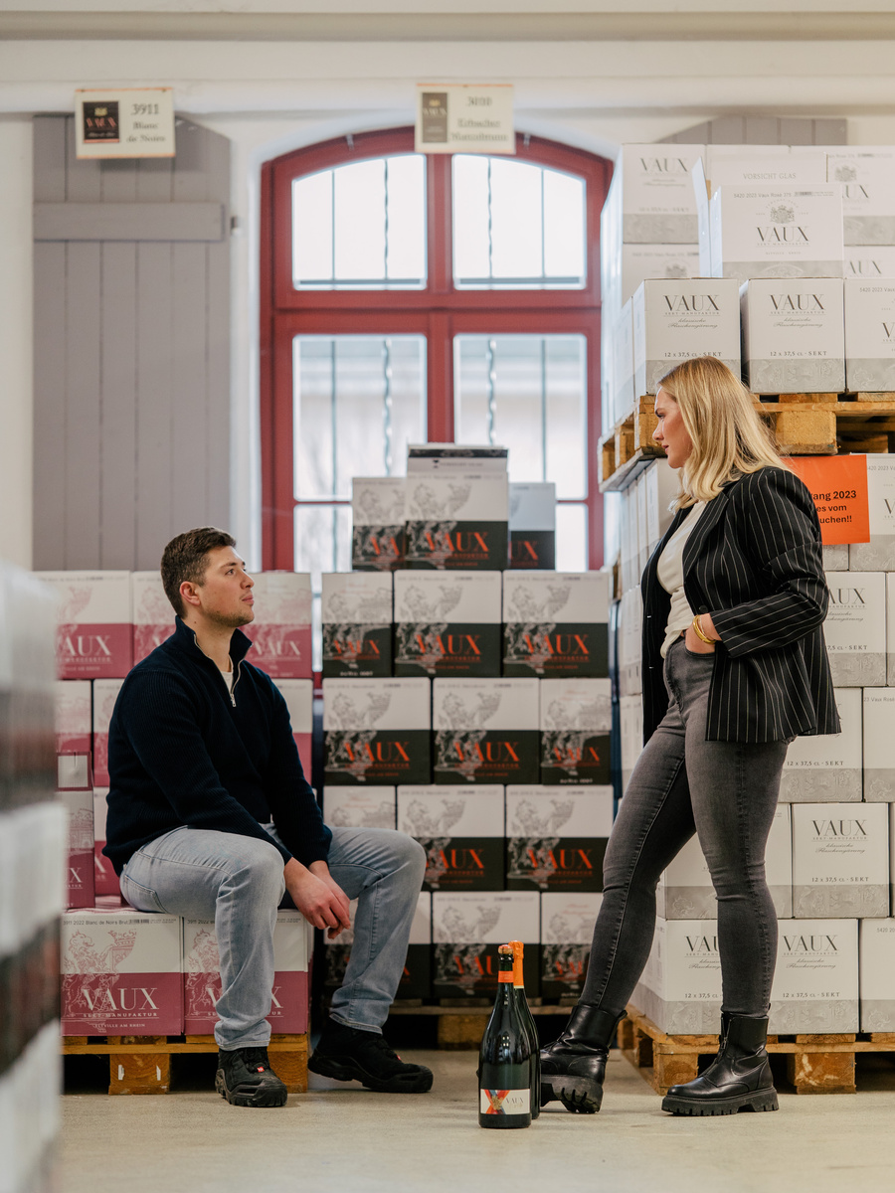
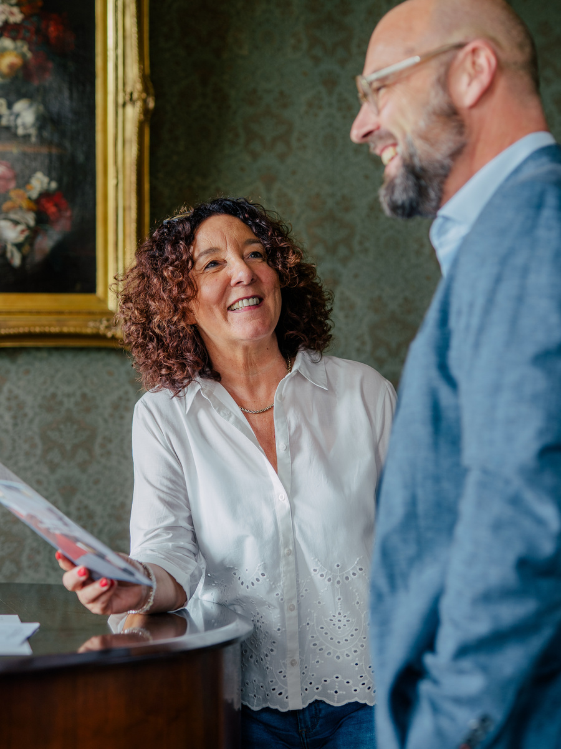
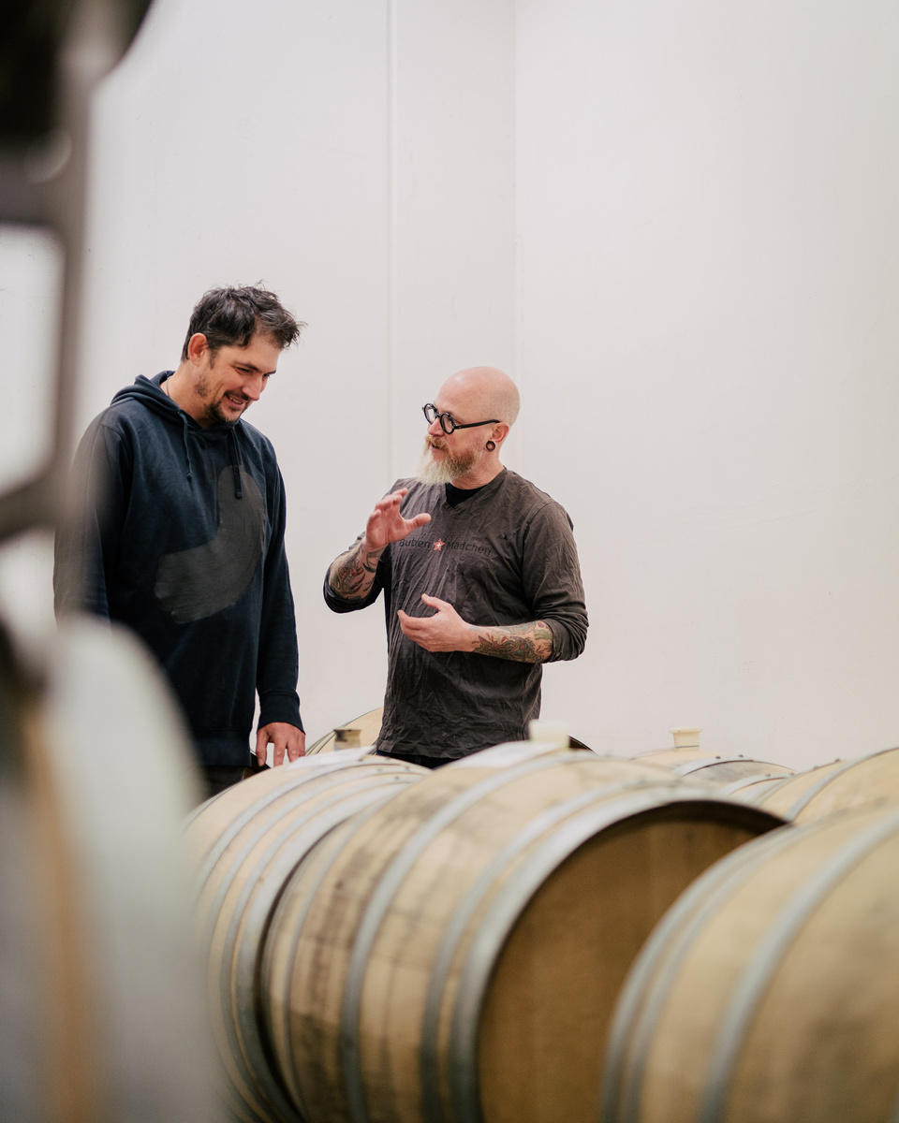
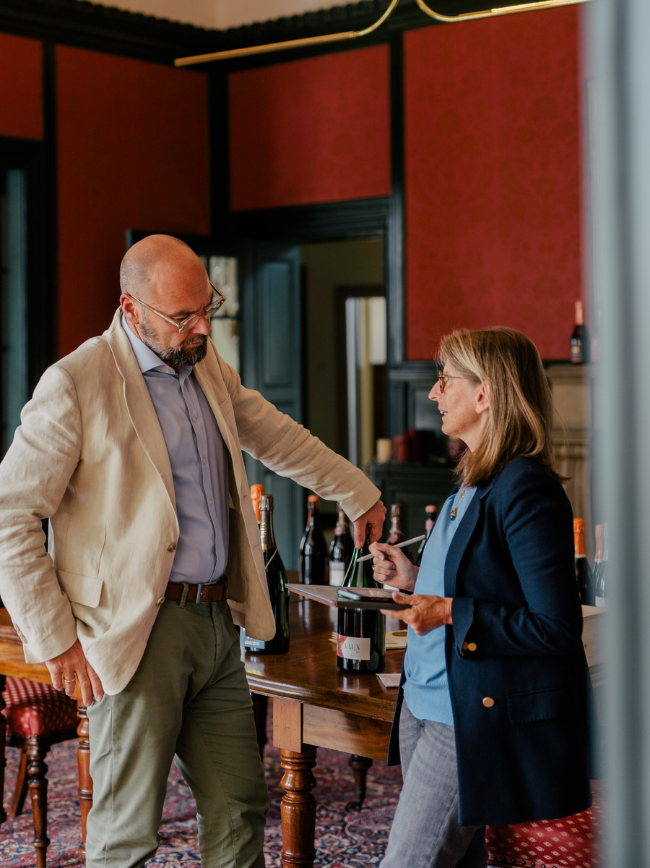
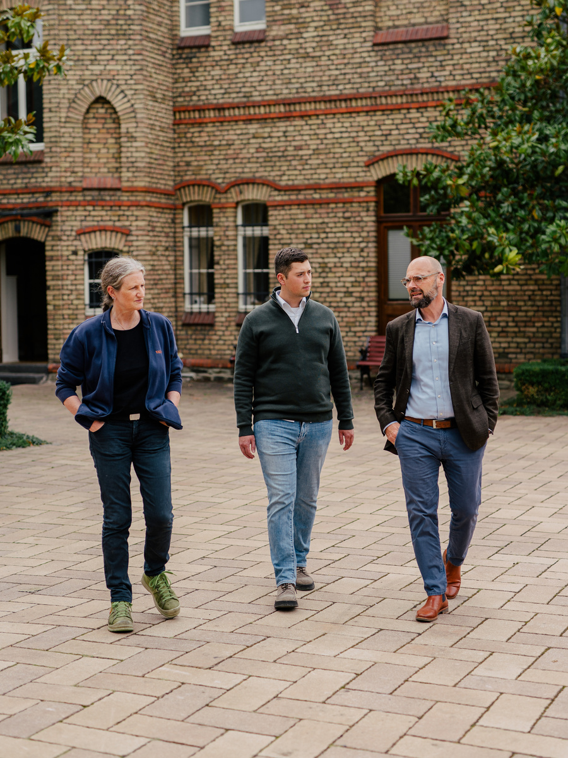
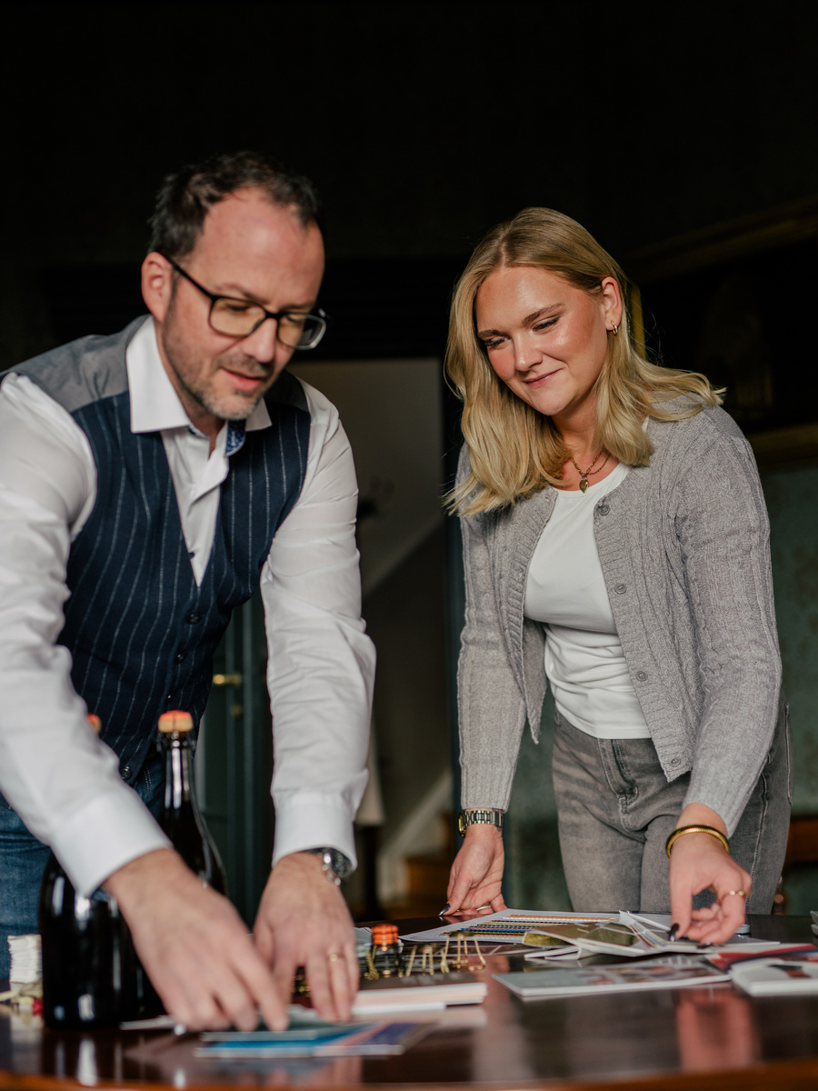
TEAM
VAUX
A SMALL TEAM WITH SIGNIFICANT IMPACT
ENERGY THAT INSPIRES
CRAFT DRIVEN BY PASSION
EVERY INDIVIDUAL CONTRIBUTES

Slide 10
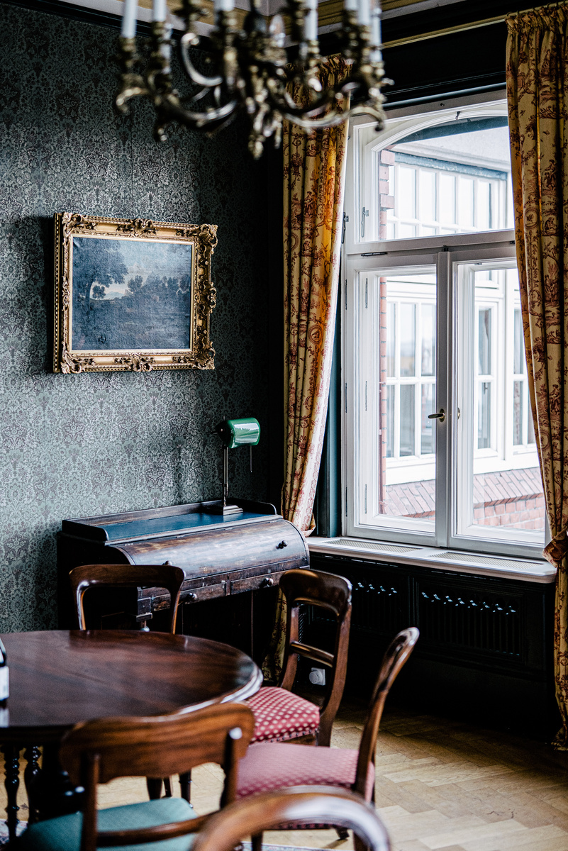
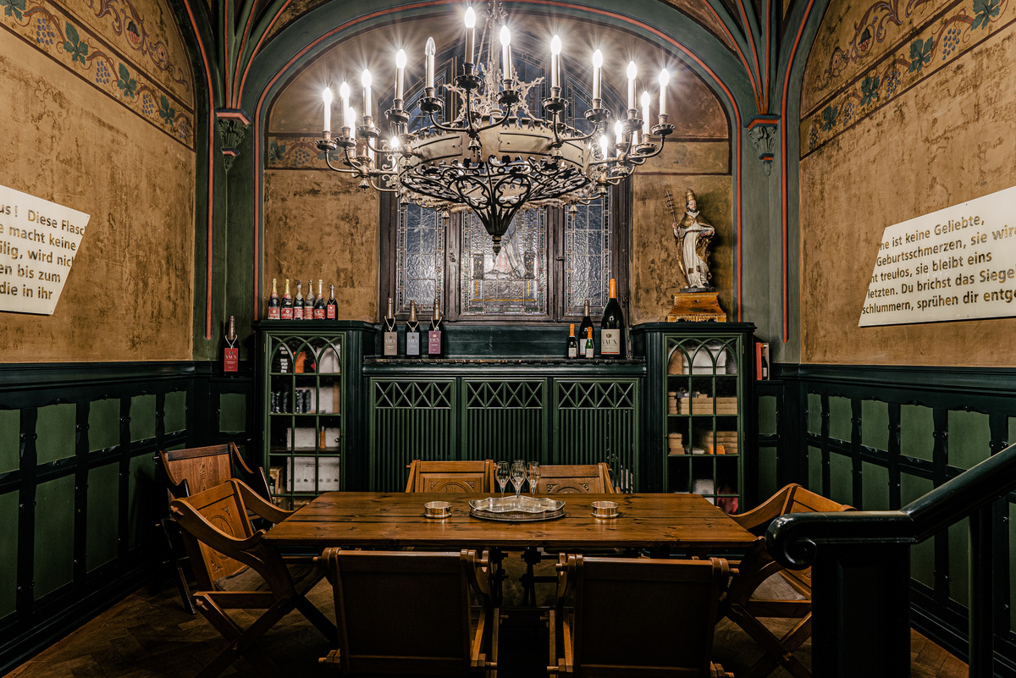
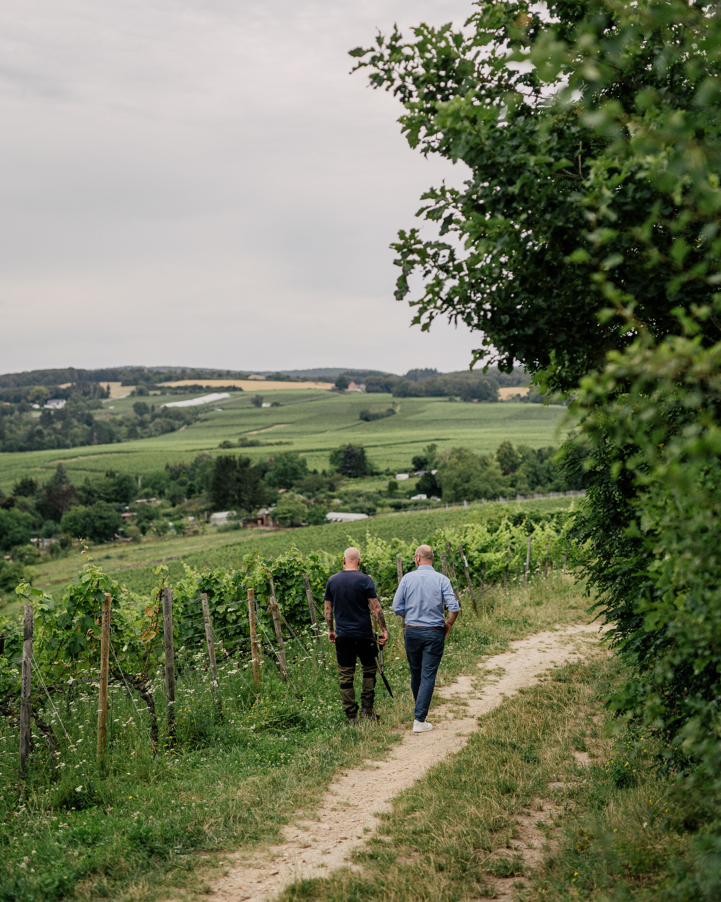





ORIGIN
& HOME
BERLIN.
METZ.
ELTVILLE.

Slide 11

BURG CRASS
OUR FUTURE HOME

Slide 12





A PLACE TO DISCOVER, ENJOY AND CONNECT
TASTINGS, EVENTS, ENCOUNTERS
SPARKLING WINE AS A LIVED EXPERIENCE

